Slide 1

Good News: Spring is here!

Slide 2


Slide 3
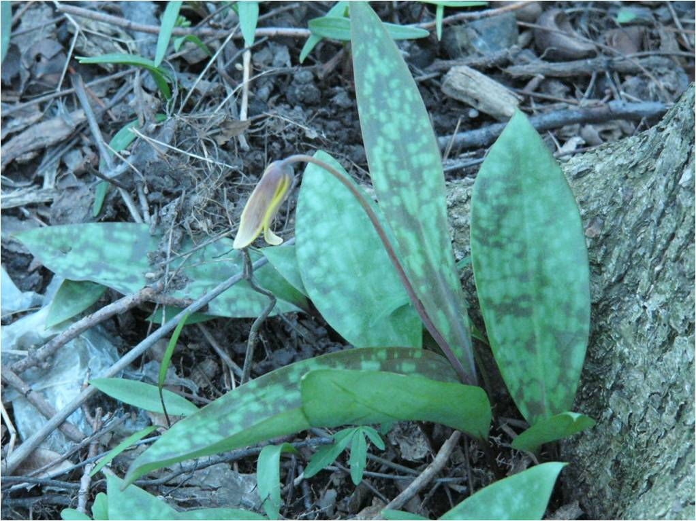

Slide 4


Slide 5

The Good News of the Cross

Slide 6
Bad News—Good News
From the very beginning (Genesis 1-3) Bad news is countered with good news!
Bad News: Sin introduced—But someday the Tempter would be defeated
“And I will put enmity between you (the Serpent) and the woman, and between your seed and her seed (singular); He shall bruise you on the head, and you shall bruise him on the heel.” (Genesis 3:15)
The great dragon, the serpent of old, the devil, Satan would be defeated (Revelation 12:9)

Slide 7
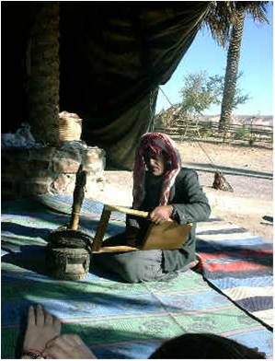
Bad News—Good News
Bad news: Abraham and Sarah lived their lives having no child
Good news: God gave them the baby Isaac!
But more good news—God promised to give them many descendants, land, and God said, “And in you all the families of the earth will be blessed” (Genesis 12:3)

Slide 8

Abraham heard good news!
Through Abraham’s descendant all the families of the earth would be blessed
Paul said that Abraham had the “good news” preached to him…
“The Scripture, foreseeing that God would justify the Gentiles by faith, preached the gospel beforehand to Abraham, saying, ‘All the nations will be blessed in you.’ ” (Galatians 3:8)
The Greek word translated “gospel” literally means “good news” (Greek EUANGELION)
The good news is that we can be justified through faith in Jesus Christ who died & rose!

Slide 9
Bad News—Good News
God’s Holy One would die—but not undergo decay (Psalm 16)
Jerusalem would be destroyed because the people broke their covenant—But God would make a new and much better covenant where sins were forgiven (Jeremiah 31)
Gloom would come to northern Israel—But some future day the Light would come, a Son would be born (Isaiah 9)
God’s Servant would be rejected and killed—but he would find new life (Isaiah 53)
Kingdoms would fall—But God would establish a kingdom that would last forever (Daniel 2)
These and dozens of other prophecies were fulfilled in what Jesus Christ, the Son of God, did for us!

Slide 10
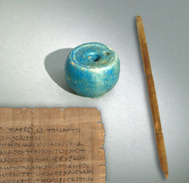
The Core of the Gospel is the Basis of the ultimate Good News…
Paul shows that in 1 Corinthians 15—a good news chapter
“1 Now I make known to you, brethren, the gospel which I preached to you…3For I delivered to you as of first importance what I also received, that Christ died for our sins according to the Scriptures, 4 and that He was buried, and that He was raised on the third day according to the Scriptures, 5 and that He appeared to Cephas, then to the twelve. 6 After that He appeared to more than five hundred brethren at one time, most of whom remain until now…” (15:1-6)
Lots of eye-witnesses still alive
Paul writing in the 50’s AD—just 20 years after the events happened!

Slide 11
This is all good news for you!
You can have victory over your sinful self
You can live without fear of death
You can live with a daily hope of heaven
You can have a family of people who care about your life
You can grow in the fruit of the Spirit—love, joy, peace, goodness, kindness, self-control
You can rejoice—having real satisfaction and encouragement that the world can’t take away from you

Slide 12
In the Lord’s supper…
We come together to rejoice in the “good news”
In “good news” that is full of hope and satisfaction
And it is all based on what Jesus did for us at the cross!
Thank God for good news!

