Slide 1
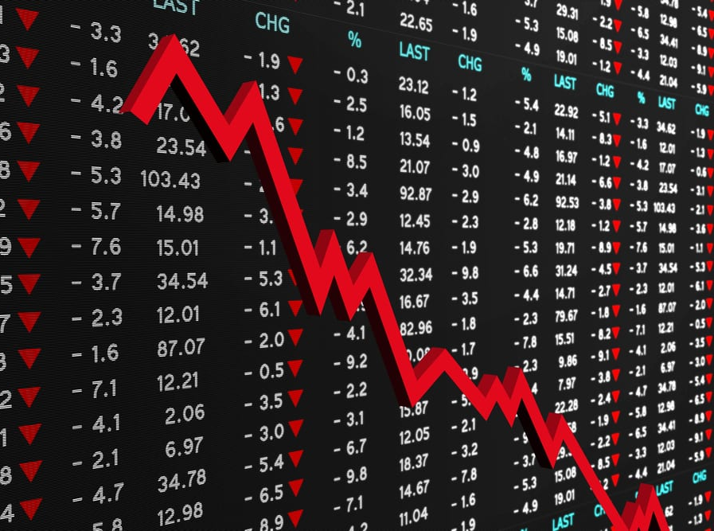
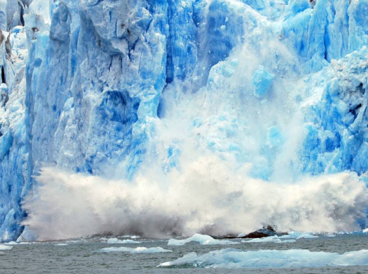
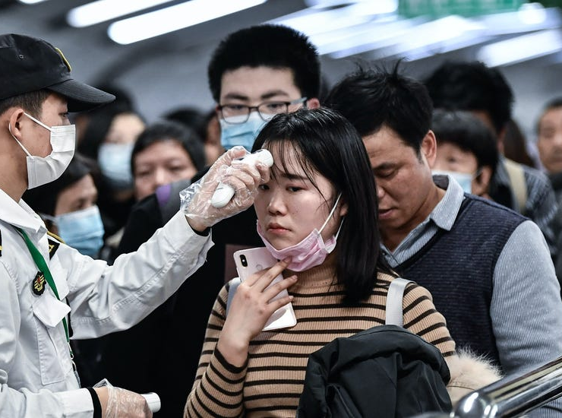
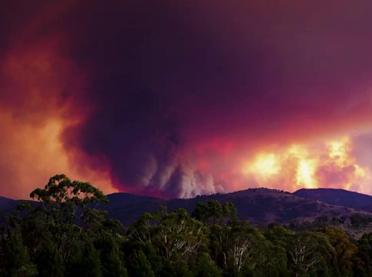

Slide 2
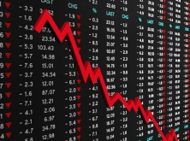
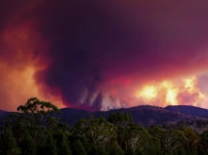
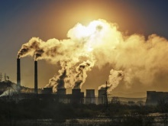
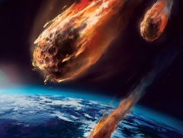
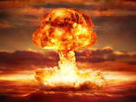
1) God is in Control
He holds all things together.

Slide 3
Heb. 1:3 “And He is the radiance of His glory and the exact representation of His nature, and upholds all things by the word of His power.”

Slide 4
1) God is in Control
He holds all things together.
Everything that happens is either caused or allowed by Him for His own perfect purpose.
All of His promises remain true.
Isa 46:10 NIV “I make known the end from the beginning, from ancient times, what is still to come. I say, 'My purpose will stand, and I will do all that I please.'”

Slide 5
Gen. 8:21-22 “The LORD smelled the soothing aroma; and the LORD said to Himself, "I will never again curse the ground on account of man, for the intent of man's heart is evil from his youth; and I will never again destroy every living thing, as I have done. (22) "While the earth remains, Seedtime and harvest, And cold and heat, And summer and winter, And day and night Shall not cease."

Slide 6
Gen. 8:21-22 “The LORD smelled the soothing aroma; and the LORD said to Himself, "I will never again curse the ground on account of man, for the intent of man's heart is evil from his youth; and I will never again destroy every living thing, as I have done. (22) "While the earth remains, Seedtime and harvest, And cold and heat, And summer and winter, And day and night Shall not cease."

Slide 7
1) God is in Control
He holds all things together.
Everything that happens is either caused or allowed by Him for His own perfect purpose.
All of His promises remain true.
Matt. 6:25-26 “For this reason I say to you, do not be worried about your life, as to what you will eat or what you will drink; nor for your body, as to what you will put on. Is not life more than food, and the body more than clothing? (26) "Look at the birds of the air, that they do not sow, nor reap nor gather into barns, and yet your heavenly Father feeds them. Are you not worth much more than they?”

Slide 8
2) Death is certain
Our bodies weren’t made to last forever.

Slide 9
Gen. 3:19 “By the sweat of your face You will eat bread, Till you return to the ground, Because from it you were taken; For you are dust, And to dust you shall return."

Slide 10
2) Death is certain
Our bodies weren’t made to last forever.
We only have a limited time here.
Ps. 90:10-12 “As for the days of our life, they contain seventy years, Or if due to strength, eighty years, Yet their pride is but labor and sorrow; For soon it is gone and we fly away. (11) Who understands the power of Your anger And Your fury, according to the fear that is due You? (12) So teach us to number our days, That we may present to You a heart of wisdom.”

Slide 11
3) Jesus came to save us
God desires a relationship with His creation.
God planned to send His Son to die for our sins.

Slide 12
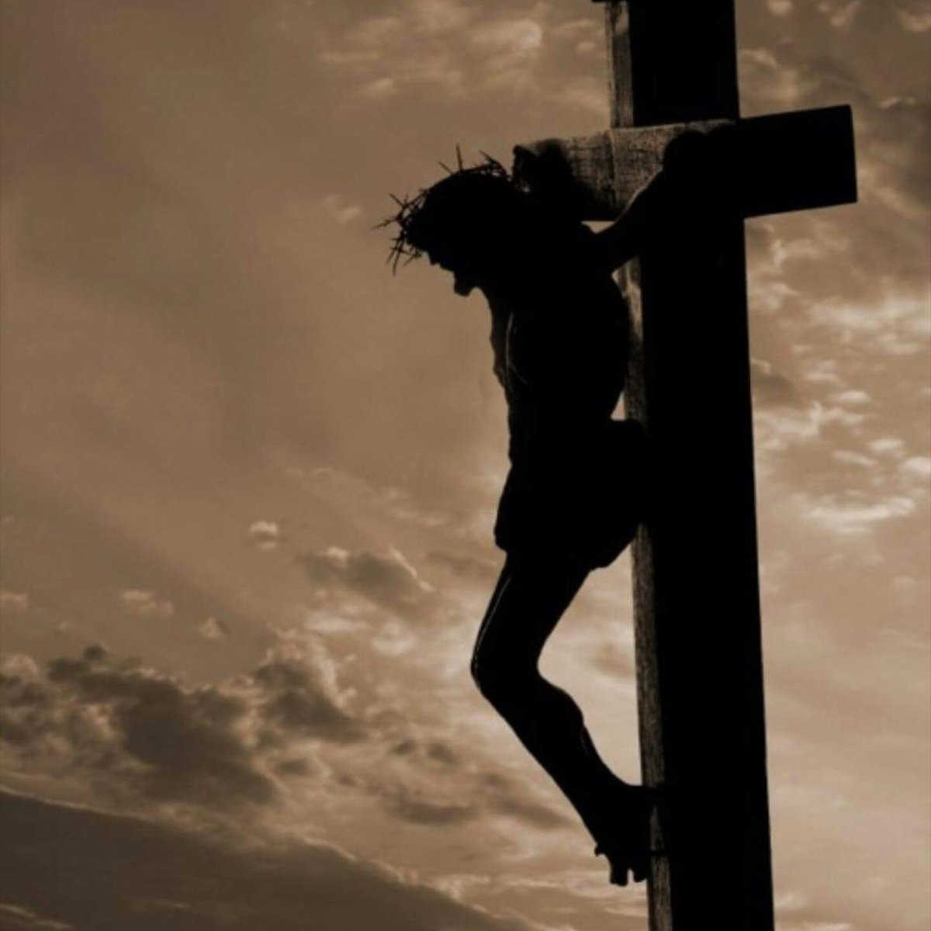
Jn. 3:16 “For God so loved the world, that He gave His only begotten Son, that whoever believes in Him shall not perish, but have eternal life.”
Rom. 5:8 “But God demonstrates His own love toward us, in that while we were yet sinners, Christ died for us.”

Slide 13
4) You’re meant for something greater
Life is not about this world.
We don’t have to fear death.
We have assurance of our resurrection.
1 Pet. 1:3-5 “Blessed be the God and Father of our Lord Jesus Christ, who according to His great mercy has caused us to be born again to a living hope through the resurrection of Jesus Christ from the dead, to obtain an inheritance which is imperishable and undefiled and will not fade away, reserved in heaven for you, (5) who are protected by the power of God through faith for a salvation ready to be revealed in the last time.”
Phil. 1:23 “But I am hard-pressed from both directions, having the desire to depart and be with Christ, for that is very much better;”

Slide 14
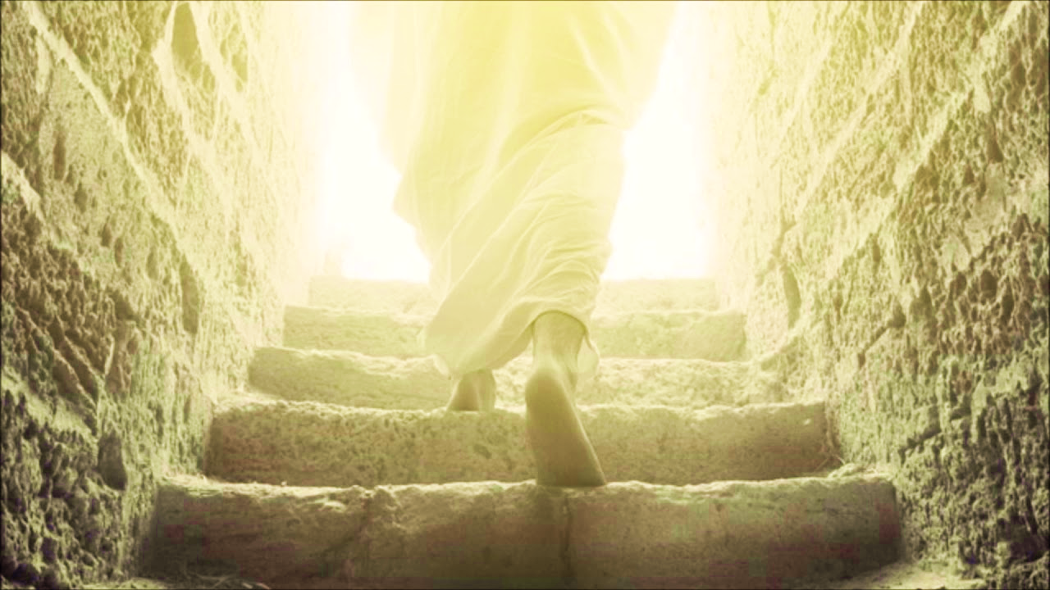
1 Cor. 15:54 “But when this perishable will have put on the imperishable, and this mortal will have put on immortality, then will come about the saying that is written, "DEATH IS SWALLOWED UP in victory.”

Slide 15
4) You’re meant for something greater
2Cor. 4:17-18 “For this light momentary affliction is preparing for us an eternal weight of glory beyond all comparison, (18) as we look not to the things that are seen but to the things that are unseen. For the things that are seen are transient, but the things that are unseen are eternal.”
Life is not about this world.
We don’t have to fear death.
We have assurance of our resurrection.
The resurrection should change our perspective.

Slide 16
5) Love will remain

Slide 19
5) Love will remain
God is love and He will never stop loving us.
Rom. 8:38-39 ESV “For I am sure that neither death nor life, nor angels nor rulers, nor things present nor things to come, nor powers, (39) nor height nor depth, nor anything else in all creation, will be able to separate us from the love of God in Christ Jesus our Lord.”

Slide 20
1) God is in Control 2) Death is certain 3) Jesus came to save us 4) You’re meant for something greater 5) Love will remain

