Slide 3
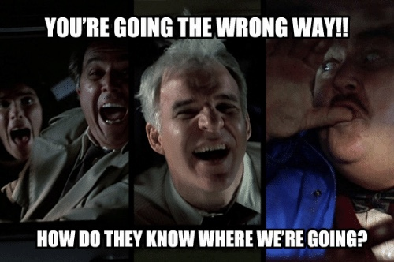

Slide 4
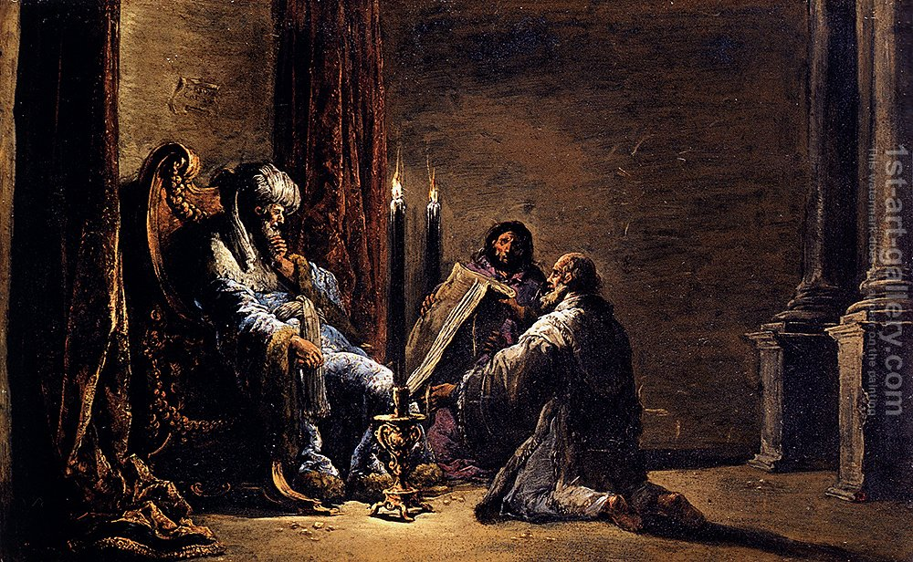
You’re Going The Wrong Way!
2 Kings 22

