Slide 1

The Life of Christ

Slide 2
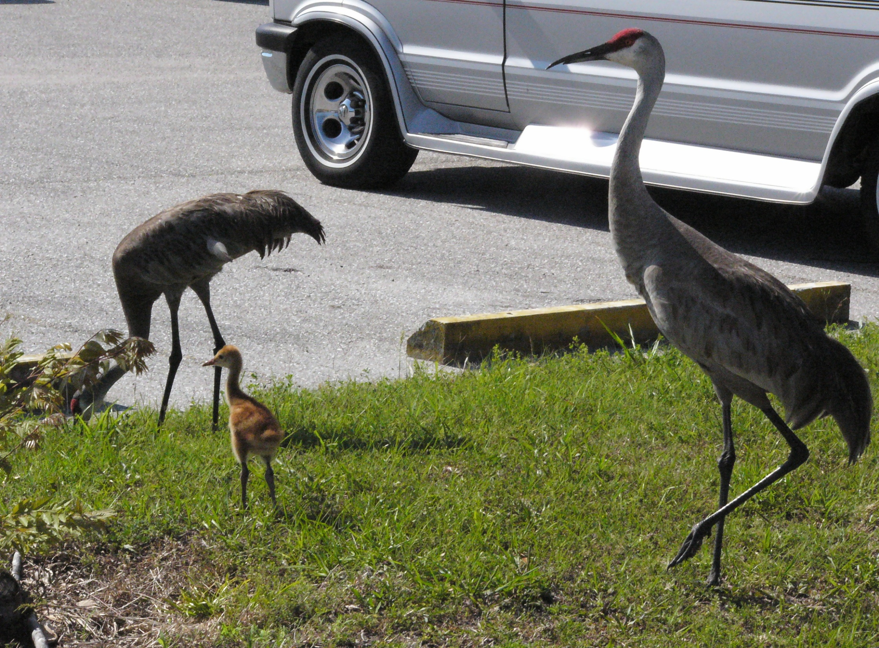
Life is wonderful, valuable and precious!

Slide 3



The wonder of life’s beginning…
The secular humanist/atheist says that life happened by chance (primordial soup)—but this is not science
Creation says “life gives birth to life”—there is no spontaneous generation of life—no matter how much time you have!
Bible teaches that life began by God. God created vegetation and “living creatures” (Genesis 1:20,24) and breathed into Adam “the breath of life” (2:7)
Design in Nature gives evidence of the Designer

Slide 4
Old Testament blood sacrifice & life…
Adam & Eve and son Able and animal sacrifice begin
“3 Every moving thing that is alive shall be food for you; I give all to you, as I gave the green plant. 4 Only you shall not eat flesh with its life, that is, its blood.” (Genesis 9:3,4)
“For the life of the flesh is in the blood, and I have given it to you on the altar to make atonement for your souls; for it is the blood by reason of the life that makes atonement.” (Leviticus 17:11)
Atonement (forgiveness of sins) was possible because a “life” was given—all the Old Testament sacrifices were foreshadowing Jesus Christ (Hebrews 10)

Slide 5
Jesus gave his life for us…
His blood was shed—He gave His life
“10…I came that they may have life, and have it abundantly. 11 I am the good shepherd; the good shepherd lays down His life for the sheep.” (John 10:10b-11)
  He came to give us life
  He lay His life down for us

Slide 6
Jesus gave his life for us…
“6 For while we were still helpless, at the right time Christ died for the ungodly. 7 For one will hardly die for a righteous man; though perhaps for the good man someone would dare even to die. 8 But God demonstrates His own love toward us, in that while were yet sinners, Christ died for us.” (Romans 5:6-8)

Slide 7
Jesus gave his life for us…
“For Christ also died for sins once for all, the just for the unjust, so that He might bring us to God, having been put to death in the flesh, but made alive in the spirit” (1 Peter 3:18)
He gave His life for our sins
He died to bring us to God
He died, but that wasn’t the end!
He died so that we could die to sin and live for Him
“…He Himself bore our sins in His body on the cross, so that we might die to sin and live to righteousness…”
(1 Peter 2:24)

Slide 8
His “life” that was given for us…
Was publically displayed
Was historically documented
Was prophesied in the OT prophets— “He was cut off our of the land of the living” (Acts 8:33, Isaiah 53:8)
Was a living sacrfice given for the sinner
Was a demonstration of God’s justice & love
Song: “I gave my life for Thee”

Slide 9
In the Lord’s supper…
We understand the wonderful value of life
We are amazed that God would experience life with us in order to provide the valuable sacrifice for sin—the LIFE of Christ!
We remember, His life was given for us, causing us to say… “I have been crucified with Christ; and it is no longer I who live, but Christ lives in me; and the life which I now live in the flesh I live by faith in the Son of God, who loved me and gave Himself up for me.” (Galatians 2:20)

