Slide 1
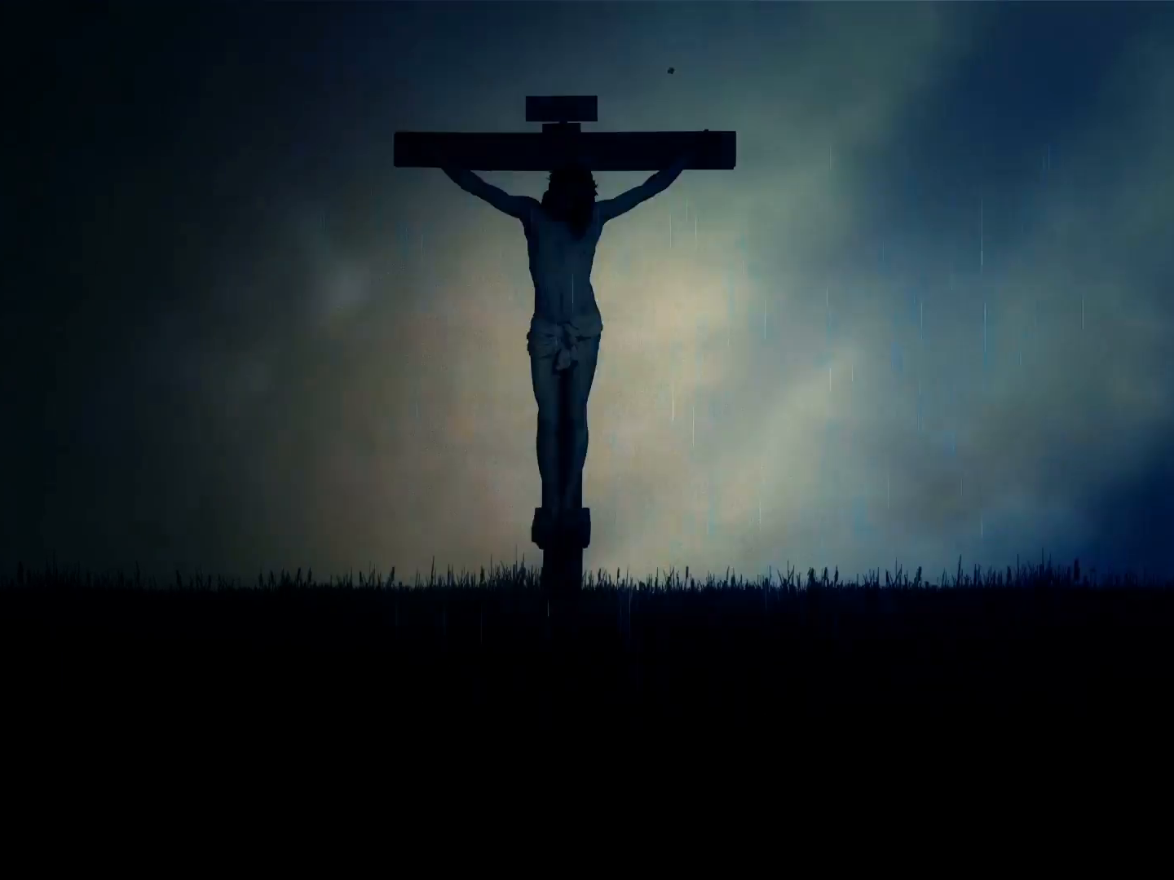
In the Darkness

Slide 2
Matt. 27:45-46 “Now from the sixth hour darkness fell upon all the land until the ninth hour. (46) About the ninth hour Jesus cried out with a loud voice, saying, "ELI, ELI, LAMA SABACHTHANI?" that is, "MY GOD, MY GOD, WHY HAVE YOU FORSAKEN ME?"

Slide 3
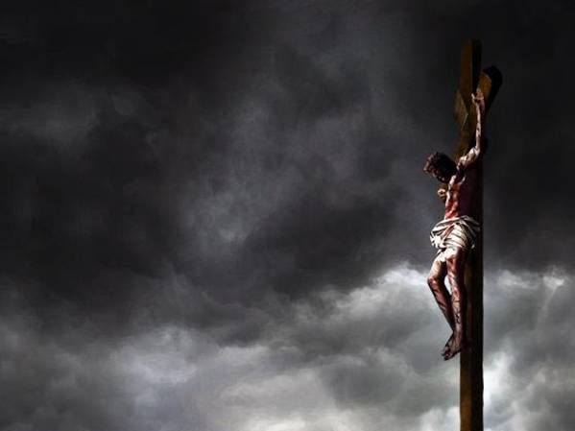
The darkness
God is the opposite of darkness. 1 Jn. 1:5
Jesus is the Light of men. Jn. 1:-4-5
Darkness is a sign of God’s judgment.
This was not natural darkness but supernatural.
It was a symbol of spiritual reality.
Amos 8:9-10 "It will come about in that day," declares the Lord GOD, "That I will make the sun go down at noon And make the earth dark in broad daylight. (10) "Then I will turn your festivals into mourning And all your songs into lamentation; And I will bring sackcloth on everyone's loins And baldness on every head. And I will make it like a time of mourning for an only son, And the end of it will be like a bitter day.”

Slide 4
The Cry
Jesus cried with a loud voice.
A scream.
Not because of the physical suffering.
Not because of the emotional suffering.

Slide 5
Infinite suffering
The darkness is the image of what is happening to Jesus spiritually.
He takes on our curse.
God’s wrath is poured out on Him.
Jesus experiences hell.
He suffered alone.
The greatest depths of suffering.
Hab. 1:13 “Your eyes are too pure to approve evil, And You can not look on wickedness with favor. …”
Gal. 3:13“Christ redeemed us from the curse of the Law, having become a curse for us--for it is written, ‘CURSED IS EVERYONE WHO HANGS ON A TREE.’”
2 Thess. 1:9 “These will pay the penalty of eternal destruction, away from the presence of the Lord and from the glory of His power,”

Slide 6
Why did Jesus do it?
For You and Me

