Slide 1
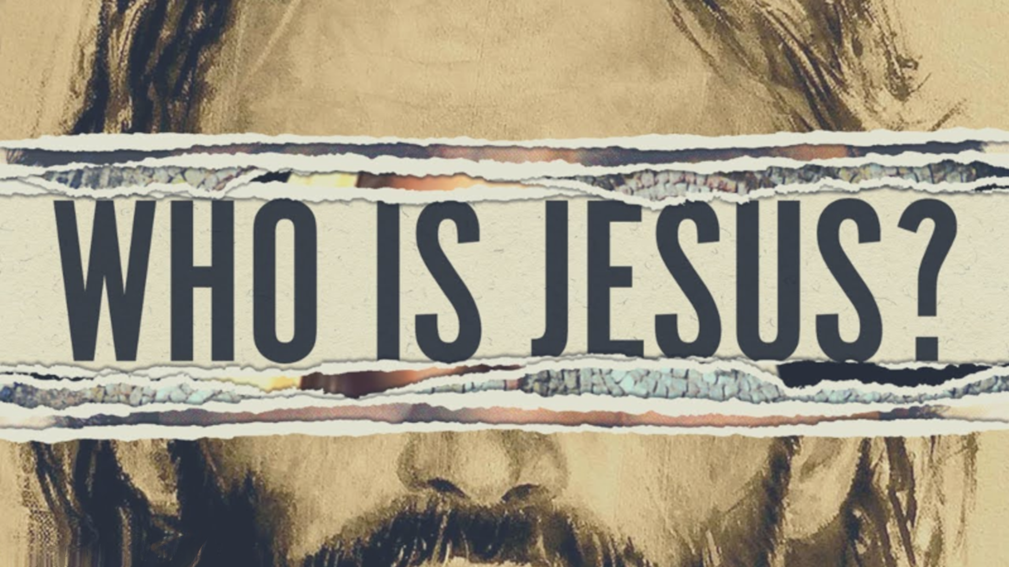

Slide 2
Who Is Jesus?
There is a divine Being who is ultimate good.
His goal is to preserve and display His infinite and awesome greatness and worth.
We were made for His glory.
Jesus is God.
God sent the Word to help us understand His glory.
The Word is God.
The Word became flesh.

Slide 3
Jesus is Savior.
We are in need of a Savior.
Jesus sacrificed Himself for our sins.
He is the way back to God.
Jesus is Lord.
Our Savior was raised from the dead.
He is Lord over all things.
He has all authority.
His Lordship gives us a new identity and priority.

Slide 4
Jesus is King
Acts 2:36 “Therefore let all the house of Israel know for certain that God has made Him both Lord and Christ--this Jesus whom you crucified.”

Slide 5
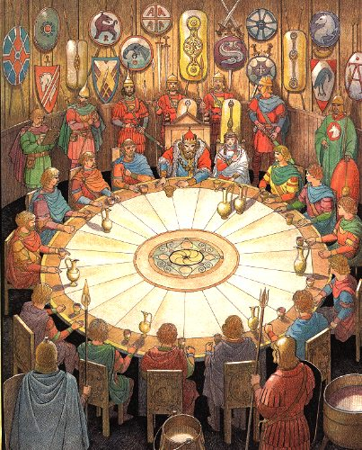
We long for a King
Stories of a good king
Once upon a time there was a good king…

Slide 6
We long for a King
This is our story.
There was a good kingdom ruled by God.
Man ruled as princes in the kingdom.
Sin caused the King to go away.
History was waiting for the return of the King.
In the fullness of time He did return.
He established a spiritual kingdom.
We were made for a king.

Slide 7
Our king Psalm 2
There is a true King v.4-9
God has set His King above all kings.
A true king is for His people.
Ps. 100:4-5 “Enter His gates with thanksgiving And His courts with praise. Give thanks to Him, bless His name. (5) For the LORD is good; His lovingkindness is everlasting And His faithfulness to all generations.”
Matt. 11:29-30 “Take My yoke upon you and learn from Me, for I am gentle and humble in heart, and YOU WILL FIND REST FOR YOUR SOULS. (30) "For My yoke is easy and My burden is light."

Slide 8
Our king
There is a true King v.4-9
God has set His King above all kings.
A true king is for His people.
A true king battles for His people.
He provides protection.
Heb. 2:14-15 “Therefore, since the children share in flesh and blood, He Himself likewise also partook of the same, that through death He might render powerless him who had the power of death, that is, the devil, (15) and might free those who through fear of death were subject to slavery all their lives.”
1Kg. 4:24-25 “For he had dominion over everything west of the River, from Tiphsah even to Gaza, over all the kings west of the River; and he had peace on all sides around about him. (25) So Judah and Israel lived in safety, every man under his vine and his fig tree, from Dan even to Beersheba, all the days of Solomon.”
Ps. 3:3 “But You, O LORD, are a shield about me, My glory, and the One who lifts my head.”

Slide 9
Our king
We hate the King v.1-3
The nations seek to tear off their fetters.
Fetters = yoke
We hate the idea of one having rights over us.
If we reject the true King we seek to find a substitute king.
Rom. 8:7 “because the mind set on the flesh is hostile toward God; for it does not subject itself to the law of God, for it is not even able to do so, (8) and those who are in the flesh cannot please God.”

Slide 10
Our king
We need the King v.10-12
It is all or nothing with the true King.
His yoke becomes our refuge.
Loving the King fills our deepest needs.
We serve Him and He serves us.
We kiss Him and He kisses us.

Slide 11
Our king
How to treat Jesus as King.
Obedience – Are you willing to obey God no matter what you think of His commands?
Worship/serve the Lord with reverence.
Submission – Are you willing to accept what comes into your life as God’s plan for you?
With reverence
Reliance – Do you rely on Jesus more than anything else?
Kiss the Son
Expectation – Do you think your problems are too big for our King?
Rejoice with trembling
What would it look like to stop treating Jesus as simply a role model and start serving Him as our sovereign king? Clayton Kraby

