Slide 2
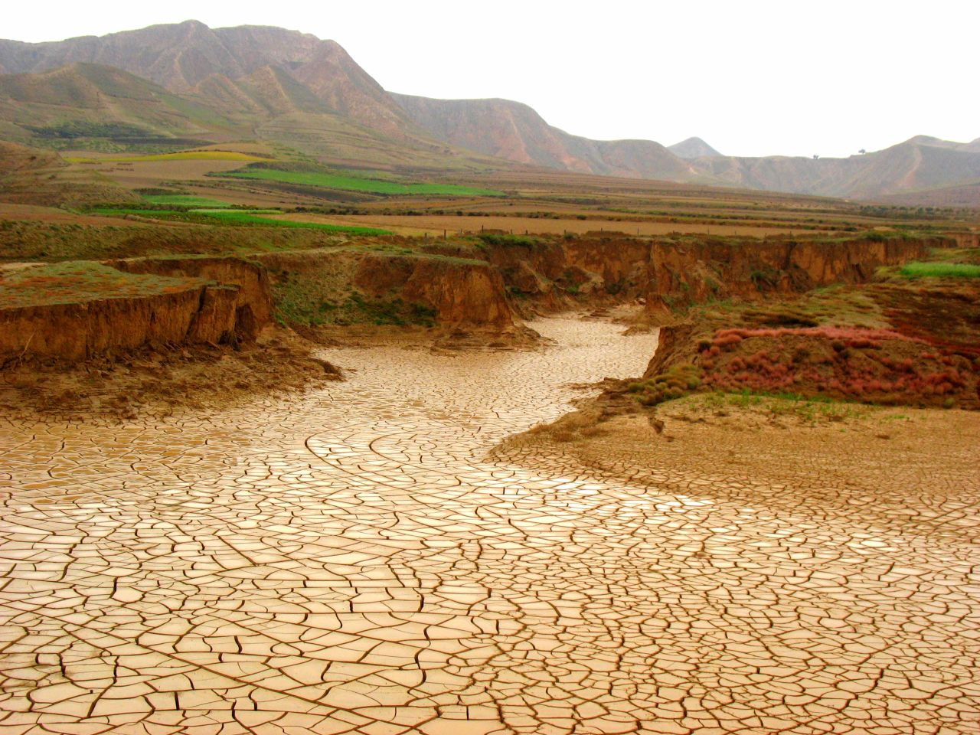
When the Brook Dries Up
1 Kings 17: 1-9

Slide 3
What are we to trust in?
God provides…
Protection for Elijah

Slide 5
What are we to trust in?
God provides…
Protection for Elijah
For his physical needs
Loss

Slide 6
What are we to trust in?
A test of the gift or the Giver
There is a difference between trusting in the gift and trusting in the Giver.
It is easy to trust as long as the gift is good.
To trust in the gift is to seek God only for the good things He can give us.
“Unbelief sees God through circumstances.” Meyers

Slide 7
What are we to trust in?
A test of the gift or the Giver
Elijah trusted in the Giver. Heb. 6:17-18
We are to trust in the Word of God.
Trust to know God is working for us because His word is true. Jas. 1:17; Rom. 8:28
Heb. 6:17-18 “In the same way God, desiring even more to show to the heirs of the promise the unchangeableness of His purpose, interposed with an oath, (18) so that by two unchangeable things in which it is impossible for God to lie, we who have taken refuge would have strong encouragement to take hold of the hope set before us.”
“Faith is not a sense, nor sight, nor reason, but a taking God at His word.” – Evans
Jas. 1:17 “Every good thing given and every perfect gift is from above, coming down from the Father of lights, with whom there is no variation or shifting shadow.”
Rom.8:28 “And we know that God causes all things to work together for good to those who love God, to those who are called according to His purpose.”

Slide 8
When are we to trust?
Look at the moment that God provided for Elijah.
Day after day Elijah waited and watched.
Only when nothing was left did God come to his aid.

Slide 10
When are we to trust?
Look at the moment that God provided for Elijah.
Day after day Elijah waited and watched.
Only when nothing was left did God come to his aid.
Elijah patiently and unwaveringly trusted from beginning to end.
The answer for us is to trust God always.

Slide 11
When are we to trust?
Do we trust always?
Many of us would have gotten anxious and started planning long before the water dried up.
The problem is our worry becomes a lack of faith.
In anxiety we aren’t allowing God to be God. Ps. 37:5
“The beginning of anxiety is the end of faith, and the beginning of true faith is the end of anxiety.” – George Mueller
Ps. 37:5 “Commit thy way unto the LORD; trust also in him; and he shall bring it to pass.”

Slide 12
When are we to trust?
How to always trust in God.
Remember where you are.

Slide 13
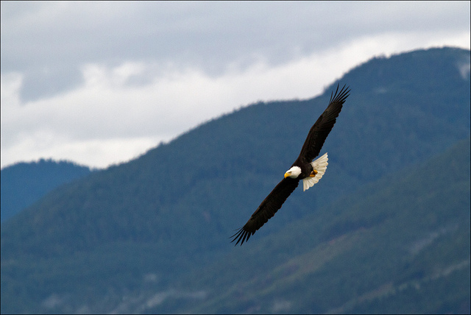
“The eagle that soars in the upper air does not worry itself as to how it is to cross rivers.”

Slide 14
When are we to trust?
How to always trust in God.
Remember where you are.
We are children of God raised to sit in heavenly places. Eph. 2:6-7
This should change our perspective.
Eph. 2:6-7 “ and raised us up with Him, and seated us with Him in the heavenly places in Christ Jesus, (7) so that in the ages to come He might show the surpassing riches of His grace in kindness toward us in Christ Jesus.”

Slide 15
Ps. 121:1-2 I will lift up my eyes to the mountains; From where shall my help come? (2) My help comes from the LORD, Who made heaven and earth.

