Slide 2
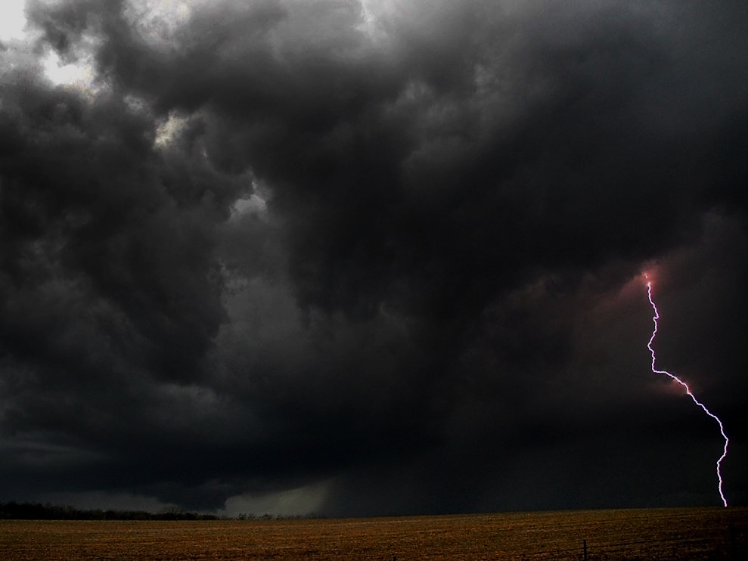
THE VOICE SPEAKING TO US

Slide 3
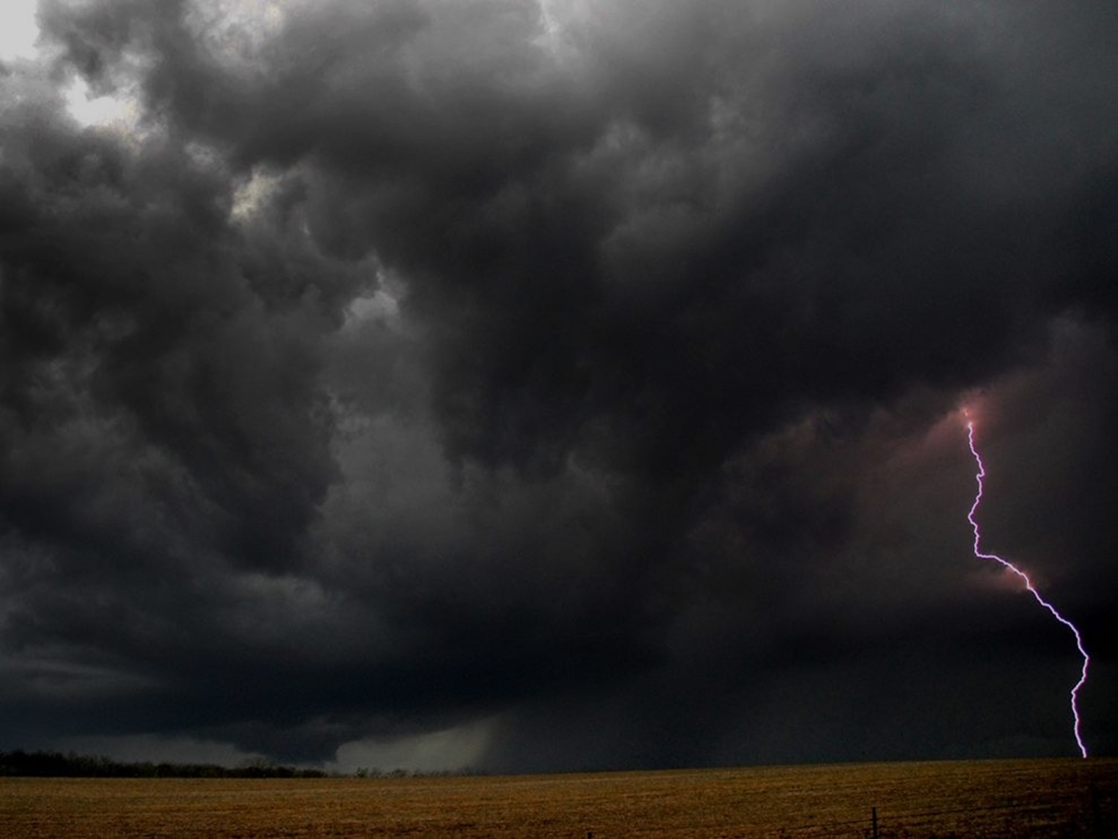
Psalm 29
A call
A call to the mighty ones
Ascribe – to give
A call to honor His name and worship the Lord.
Acknowledge His supreme worth
Bow down – to show His worth by subordinating our hearts, wills, and minds to Him.
Worship in holy array – come with a heart of purity and holiness.

Slide 4
Psalm 29
The storm – the power of the Almighty
The voice of God is described as thunder. Ps. 18:13; Jn. 12:28-30

Slide 5
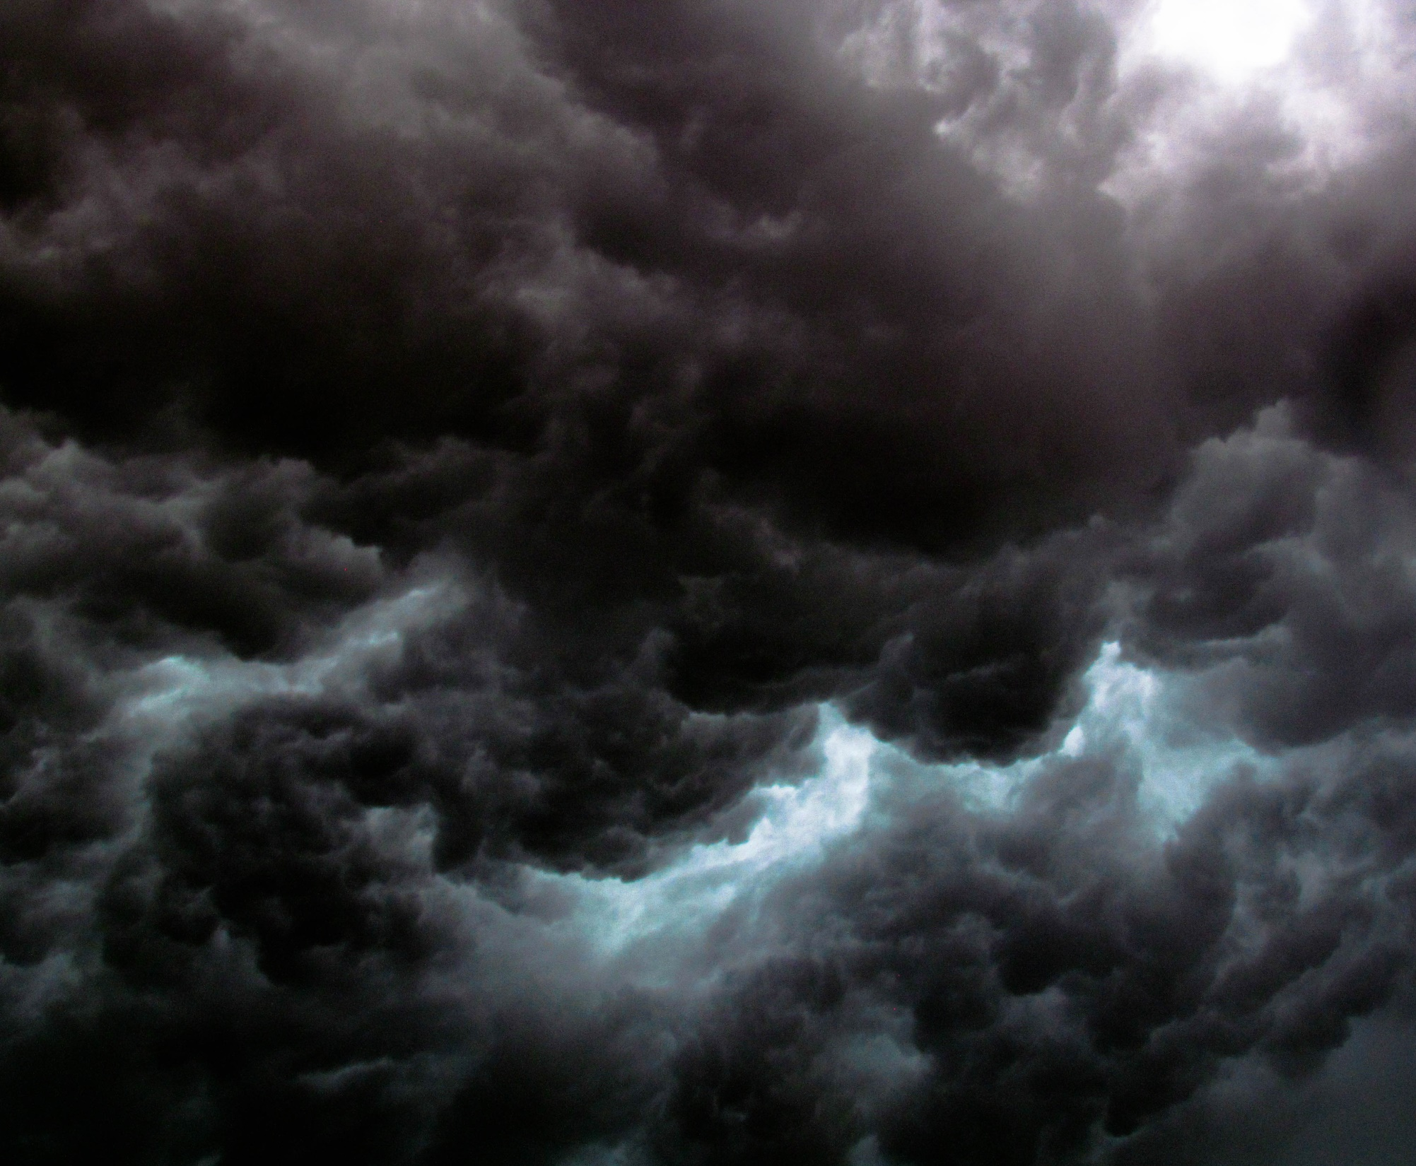
Ps. 18:13 “The Lord also thundered in the heavens, and the Most High uttered His voice,”

Slide 6
Jn. 12:28-30 ESV Father, glorify your name." Then a voice came from heaven: "I have glorified it, and I will glorify it again." (29) The crowd that stood there and heard it said that it had thundered. Others said, "An angel has spoken to him." (30) Jesus answered, "This voice has come for your sake, not mine.

Slide 7
Psalm 29
The storm – the power of the Almighty
The voice of God is described as thunder. Ps. 18:13; Jn. 12:28-30
The voice of the Lord in power, in majesty.
The voice of the Lord breaks the cedars.
He makes Lebanon skip like a calf.

Slide 9
Psalm 29
The storm – the power of the Almighty
The voice of God is described as thunder. Ps. 18:13; Jn. 12:28-30
The voice of the Lord in power, in majesty.
The voice of the Lord breaks the cedars.
He makes Lebanon skip like a calf.
The voice of the Lord hews out flames of fire.

Slide 10
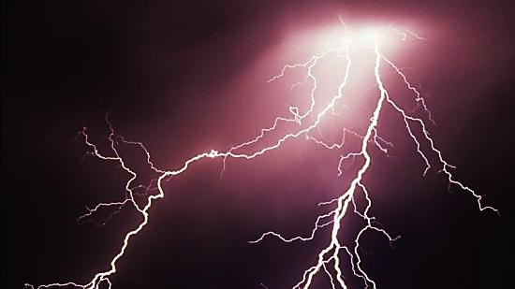

Slide 11
Psalm 29
The storm – the power of the Almighty
The voice of God is described as thunder. Ps. 18:13; Jn. 12:28-30
The voice of the Lord in power, in majesty.
The voice of the Lord breaks the cedars.
He makes Lebanon skip like a calf.
The voice of the Lord hews out flames of fire.
The voice of the Lord shakes the wilderness.

Slide 12
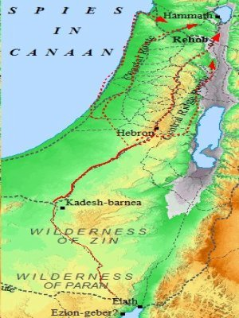

Slide 13
Psalm 29
The storm – the power of the Almighty
The voice of God is described as thunder. Ps. 18:13; Jn. 12:28-30
The voice of the Lord in power, in majesty.
The voice of the Lord breaks the cedars.
He makes Lebanon skip like a calf.
The voice of the Lord hews out flames of fire.
The voice of the Lord shakes the wilderness.
The voice of the Lord makes the deer to calve.

Slide 14
Psalm 29
The storm – the power of the Almighty
The Voice of God is described as thunder. Ps. 18:13; Jn. 12:28-30
The Voice of the Lord in power, in majesty.
The Voice of the Lord breaks the cedars.
He makes Lebanon skip like a calf.
The Voice of the Lord hews out flames of fire.
The Voice of the Lord shakes the wilderness.
The Voice of the Lord makes the deer to calve.

Slide 15
The Voice
Psalm 29 begins with a call to worship.
Our purpose is to glorify God. Rev. 4:11

Slide 16
Rev. 4:11 “Worthy are You, our Lord and God, to receive glory and honor and power, for You created all things, and by Your will they existed and were created.”

Slide 17
The Voice
Psalm 29 begins with a call to worship.
Our purpose is to glorify God. Rev. 4:11
In creation of the universe God sought to make the creature partake of His perfection and blessedness.
He shows in His creation the glory of His love , wisdom, and power.

Slide 18
The Voice
God is speaking.
God by His nature is continuously articulate.
In the beginning God spoke. Ps. 33:6,9
“The why of natural law is the living Voice of God immanent in His creation… The Voice of God is the most powerful force in nature, indeed the only force in nature, for all energy is here only because the power-filled Word is being spoken.” A.W.Tozer

Slide 19
Ps. 33:6,9 “By the word of the LORD the heavens were made, and by the breath of His mouth all their host. 9) For He spoke, and it came to be; He commanded, and it stood firm.”

Slide 20
The Voice
God is speaking.
God by His nature is continuously articulate.
In the beginning God spoke. Ps. 33:6,9; 90:3
God continues to speak. Rom. 1:20

Slide 21
Rom. 1:20 “For His invisible attributes, namely, His eternal power and divine nature, have been clearly perceived, ever since the creation of the world, in the things that have been made. So they are without excuse.”

Slide 22
The Voice
God is speaking.
God by His nature is continuously articulate.
In the beginning God spoke. Ps. 33:6,9; 90:3
God continues to speak. Rom. 1:20
The voice is the expression of God’s will spoken into the structure of all things.
He speaks and maintains everything moment by moment. Heb.1:3

Slide 23
Heb. 1:3 “He upholds the universe by the word of His power.”
“Humility—the place of total dependence on God—is our primary duty and highest good. That’s just how the universe is put together!” Andrew Murray

Slide 24
Our Reception
The purpose of the Voice
The purpose of speaking is to be heard.
David calls us to hear the voice of God.
“The creature sees its care, its highest virtue, its only happiness now and through all eternity, is to present itself an empty vessel, in which God can dwell and manifest His power and goodness.” Andrew Murray

Slide 25
Our Reception
Our reception of His voice.
How do we hear the Voice?

Slide 26
“When God spoke out of heaven to our Lord, self-centered men who heard it explained it by natural causes: they said, ‘It thundered.’ This habit of explaining the Voice by appeal to natural law is at the very root of modern science. In the living breathing cosmos there is a mysterious Something, too wonderful, too awful [i.e. awesome] for any mind to understand.”

Slide 27
“The believing man does not claim to understand. He falls to his knees and whispers, ‘God.’ The man of earth kneels also, but not to worship. He kneels to examine, to search, to find the cause and the how of things. Just now we happen to be living in a secular age. Our thought habits are those of the scientist, not those of the worshipper. We are more likely to explain than to adore. ‘It thundered,’ we exclaim, and go our earthly way. But still the Voice sounds and searches. The order and life of the world depend upon that Voice, but men are mostly too busy or too stubborn to give attention.”

Slide 28
Our Reception
Our reception of His voice.
How do we listen to the Voice?
When we hear Him we recognize He has been, is and ever will be the supreme King.
When we have Him as our King we have salvation in Christ and we receive His strength and peace.

