Slide 1
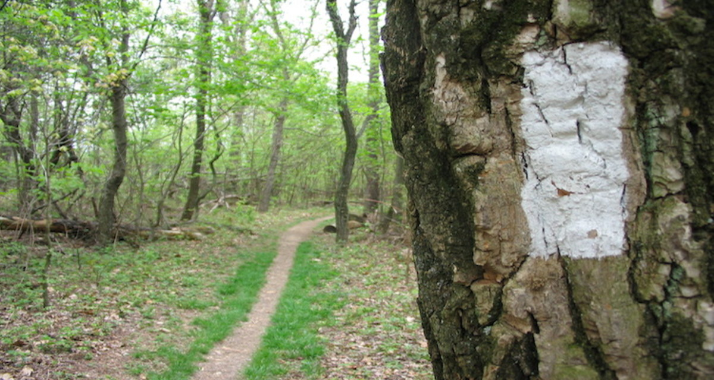

Slide 2
Marks of love
Aspects of love 1 Cor. 13:4-7
Aspects of Jesus
These are markers of spiritual growth.
They show us the path to Jesus.
They show us how far we have grown and where we need to continue to grow.

Slide 3
1Cor. 13:6 “Love does not rejoice in unrighteousness, but rejoices with the truth” ESV “it does not rejoice at wrongdoing, but rejoices with the truth” NIV “It does not delight in evil, but rejoices with the truth.”

Slide 4
Marks of love
Does not rejoice in evil.
There is a progression of sin.
Sin likes a crowd.
Ps. 1:1 “Blessed is the man who walks not in the counsel of the wicked, nor stands in the way of sinners, nor sits in the seat of scoffers;”
“Sin will not rest content with toleration of its presence; it demands “approval” and eventually “celebration”. Sinclair Ferguson

Slide 5
Rom 1:28-32 “And just as they did not see fit to acknowledge God any longer, God gave them over to a depraved mind, to do those things which are not proper, (29) being filled with all unrighteousness, wickedness, greed, evil; full of envy, murder, strife, deceit, malice; they are gossips, (30) slanderers, haters of God, insolent, arrogant, boastful, inventors of evil, disobedient to parents, (31) without understanding, untrustworthy, unloving, unmerciful; (32) and although they know the ordinance of God, that those who practice such things are worthy of death, they not only do the same, but also give hearty approval to those who practice them.”

Slide 6
Rom 1:28-32 “And just as they did not see fit to acknowledge God any longer, God gave them over to a depraved mind, to do those things which are not proper, (29) being filled with all unrighteousness, wickedness, greed, evil; full of envy, murder, strife, deceit, malice; they are gossips, (30) slanderers, haters of God, insolent, arrogant, boastful, inventors of evil, disobedient to parents, (31) without understanding, untrustworthy, unloving, unmerciful; (32) and although they know the ordinance of God, that those who practice such things are worthy of death, they not only do the same, but also give hearty approval to those who practice them.”

Slide 7
Marks of love
Rejoices with the truth.
Spiritual growth in Christ’s love guides us in a different direction.
There is a progression in the truth.
We know the truth.
We live in truth.
We rejoice with truth.
Phil. 4:8 “Finally, brothers, whatever is true, whatever is honorable, whatever is just, whatever is pure, whatever is lovely, whatever is commendable, if there is any excellence, if there is anything worthy of praise, think about these things.”
1Tim. 2:4 “who desires all men to be saved and to come to the knowledge of the truth.”
Eph 5:3-4 “But immorality or any impurity or greed must not even be named among you, as is proper among saints; (4) and there must be no filthiness and silly talk, or coarse jesting, which are not fitting, but rather giving of thanks.”
Ps. 1:2 “But his delight is in the law of the LORD, And in His law he meditates day and night.”

Slide 8
Marks of love
Rejoices with the truth.
Spiritual growth in Christ’s love guides us in a different direction.
There is a progression in the truth.
The importance of rejoicing with the truth and not in unrighteousness:
one way or another we tend to become like whatever we rejoice in.

Slide 9
What do we rejoice in?
How to tell.

Slide 11
What do we rejoice in?
How to tell.
Who we are comes out in the trivial and incidental details of our lives.
“What do you most rejoice in?... In the signs of God’s generosity to you in a work situation, or in the thought of your own reputation being advanced? In the growth in character you see in your children, or in the relief that they didn’t embarrass you in public?” Sinclair Ferguson

Slide 12
What do we rejoice in?
We rejoice in what we take in.
What we see, hear and are around each day affects our behaviors.
Behaviors only change when our minds are changed by what we take in.

Slide 13
Eph 4:17-24 “So this I say, and affirm together with the Lord, that you walk no longer just as the Gentiles also walk, in the futility of their mind, (18) being darkened in their understanding, excluded from the life of God because of the ignorance that is in them, because of the hardness of their heart; (19) and they, having become callous, have given themselves over to sensuality for the practice of every kind of impurity with greediness. (20) But you did not learn Christ in this way, (21) if indeed you have heard Him and have been taught in Him, just as truth is in Jesus, (22) that, in reference to your former manner of life, you lay aside the old self, which is being corrupted in accordance with the lusts of deceit, (23) and that you be renewed in the spirit of your mind, (24) and put on the new self, which in the likeness of God has been created in righteousness and holiness of the truth.”

Slide 14
Eph 4:17-24 “So this I say, and affirm together with the Lord, that you walk no longer just as the Gentiles also walk, in the futility of their mind, (18) being darkened in their understanding, excluded from the life of God because of the ignorance that is in them, because of the hardness of their heart; (19) and they, having become callous, have given themselves over to sensuality for the practice of every kind of impurity with greediness. (20) But you did not learn Christ in this way, (21) if indeed you have heard Him and have been taught in Him, just as truth is in Jesus, (22) that, in reference to your former manner of life, you lay aside the old self, which is being corrupted in accordance with the lusts of deceit, (23) and that you be renewed in the spirit of your mind, (24) and put on the new self, which in the likeness of God has been created in righteousness and holiness of the truth.”

Slide 15
Eph 4:17-24 “So this I say, and affirm together with the Lord, that you walk no longer just as the Gentiles also walk, in the futility of their mind, (18) being darkened in their understanding, excluded from the life of God because of the ignorance that is in them, because of the hardness of their heart; (19) and they, having become callous, have given themselves over to sensuality for the practice of every kind of impurity with greediness. (20) But you did not learn Christ in this way, (21) if indeed you have heard Him and have been taught in Him, just as truth is in Jesus, (22) that, in reference to your former manner of life, you lay aside the old self, which is being corrupted in accordance with the lusts of deceit, (23) and that you be renewed in the spirit of your mind, (24) and put on the new self, which in the likeness of God has been created in righteousness and holiness of the truth.”

Slide 16
What do we rejoice in?
We rejoice in what we take in.
What we see, hear and are around each day affects our behaviors.
Behaviors only change when our minds are changed by what we take in.
How much mind renewal have you done this past week?

