Slide 1
Stoop - 1) to bend the body or a part of the body forward and downward sometimes simultaneously bending the knees
2) to descend from a superior rank, dignity, or status.

Slide 2
Titus 3:4 “But when the kindness of God our Savior and His love for mankind appeared,”

Slide 3
LOVE Came Down

Slide 4
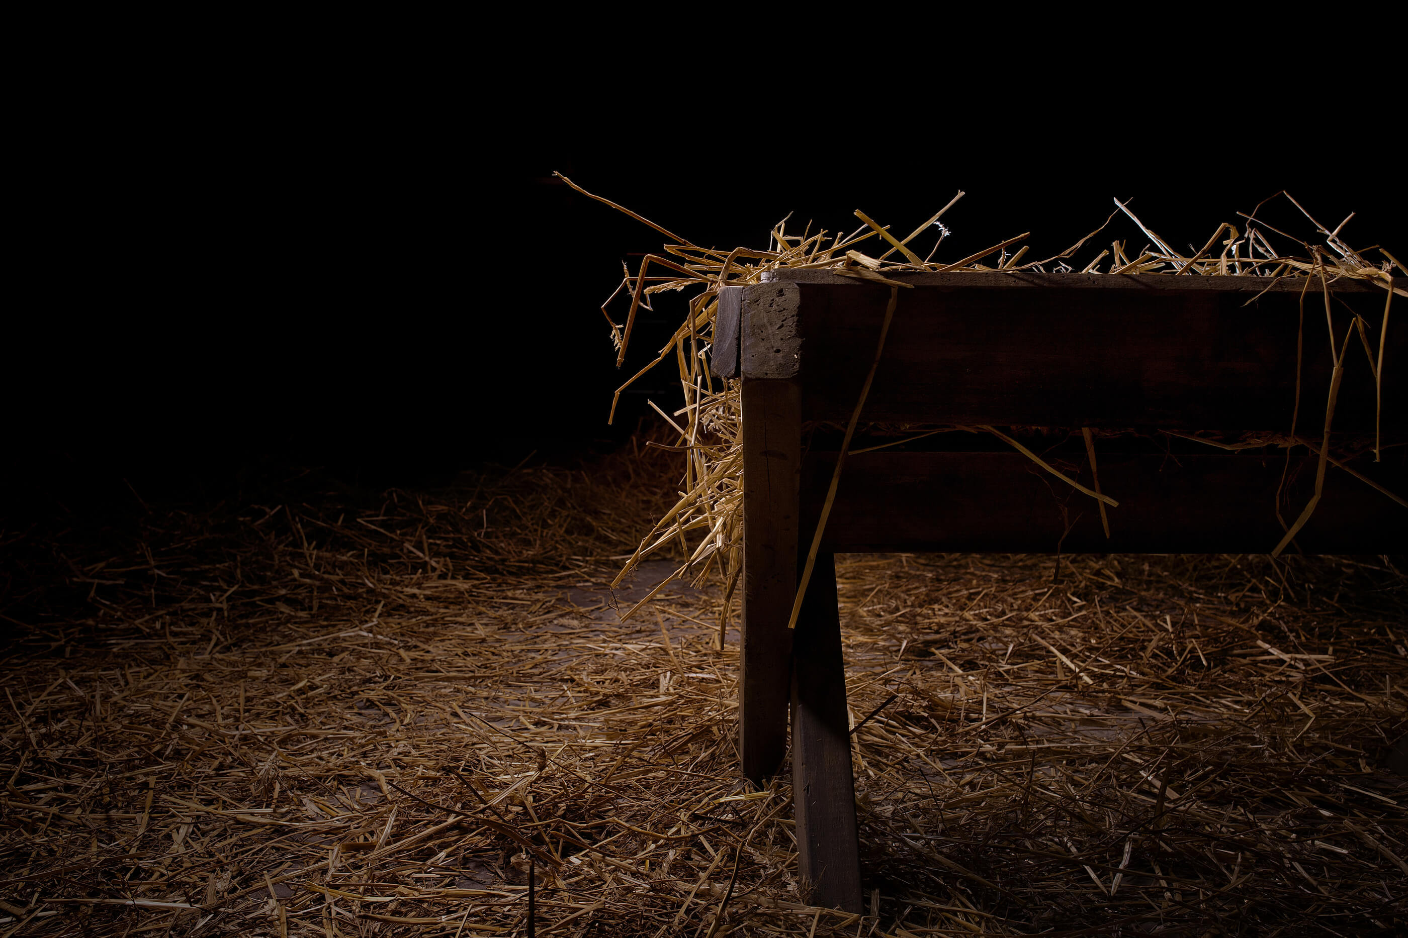
God stooped
How He came
His entrance
No fanfare
His reception
Into the arms of a peasant girl
His accommodations
A wooden feeding trough
This is God stooping down to us.
Phil. 2:6-7 “who, although He existed in the form of God, did not regard equality with God a thing to be grasped, (7) but emptied Himself, taking the form of a bond-servant, and being made in the likeness of men.”
“God was given eyebrows, elbows, two kidneys, and a spleen. He stretched against the walls and floated in the amniotic fluids of his mother.”

Slide 5
God Stooped
How He lived
Everyday life
He lived just like us
His ministry
He was a roaming preacher.
Matt. 8:20 “The foxes have holes and the birds of the air have nests, but the Son of Man has nowhere to lay His head."

Slide 6
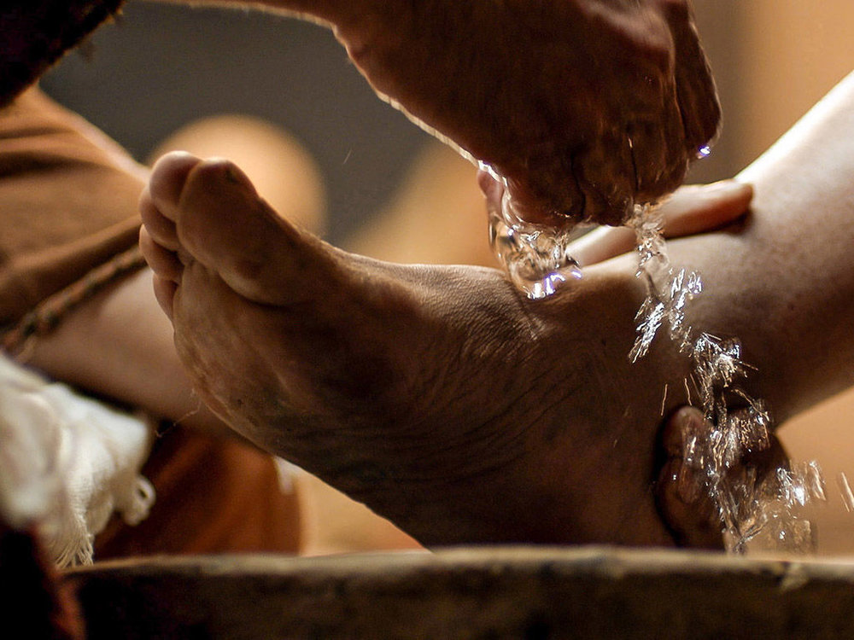

Slide 7
God Stooped
Phil 2:8 “Being found in appearance as a man, He humbled Himself by becoming obedient to the point of death, even death on a cross.”
How He lived
Everyday life
He lived just like us
His ministry
He was a roaming preacher.
His death
He died as a criminal on the cross

Slide 8
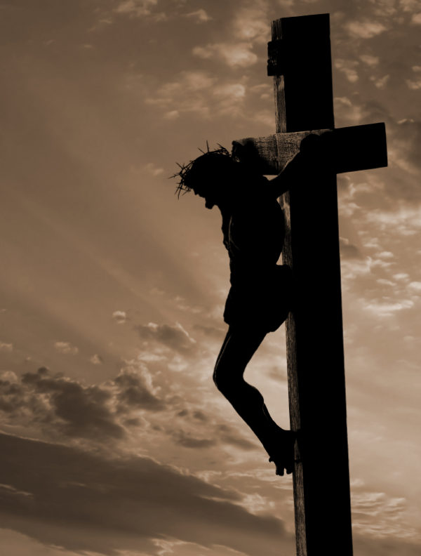
Isa. 53:4-5 “Surely our griefs He Himself bore, And our sorrows He carried; Yet we ourselves esteemed Him stricken, Smitten of God, and afflicted. (5) But He was pierced through for our transgressions, He was crushed for our iniquities; The chastening for our well-being fell upon Him, And by His scourging we are healed.”

Slide 9
God Stooped down for us
What was it all for?
Jn. 13:12-15
Jesus stooped down as an example for us.
Christ became what He was not in order that we might become what we were not.
Love comes down to lift others up.
“Only in seeing his Maker does a man truly become man. For in seeing his Creator, man catches a glimpse of what he was intended to be.” Max Lucado

Slide 10
(4) But when the kindness of God our Savior and His love for mankind appeared,

Slide 11
Titus 3:3-5 “For we also once were foolish ourselves, disobedient, deceived, enslaved to various lusts and pleasures, spending our life in malice and envy, hateful, hating one another. (4) But when the kindness of God our Savior and His love for mankind appeared, (5) He saved us, not on the basis of deeds which we have done in righteousness, but according to His mercy, by the washing of regeneration and renewing by the Holy Spirit,”

Slide 12
God Stooped down for us
What was it all for?
Jn. 13:12-15
Jesus stooped down as an example for us.
Christ became what He was not in order that we might become what we were not.
Love comes down to lift others up.
We are to imitate His stooping.
2Cor. 5:15 “and He died for all, so that they who live might no longer live for themselves, but for Him who died and rose again on their behalf.”
2Cor. 5:14 “For the love of Christ controls us, having concluded this, that one died for all, therefore all died”

Slide 13
LOVE Came Down

