Slide 1
“We have things backwards, we have only one day a year for Thanksgiving and 364 days for grumbling and complaining. We ought to have one day a year for expressing our grumbles, groans, grunts, and grouching and 364 days a year for blessing the Lord who satisfies our mouth with good things.”

Slide 2
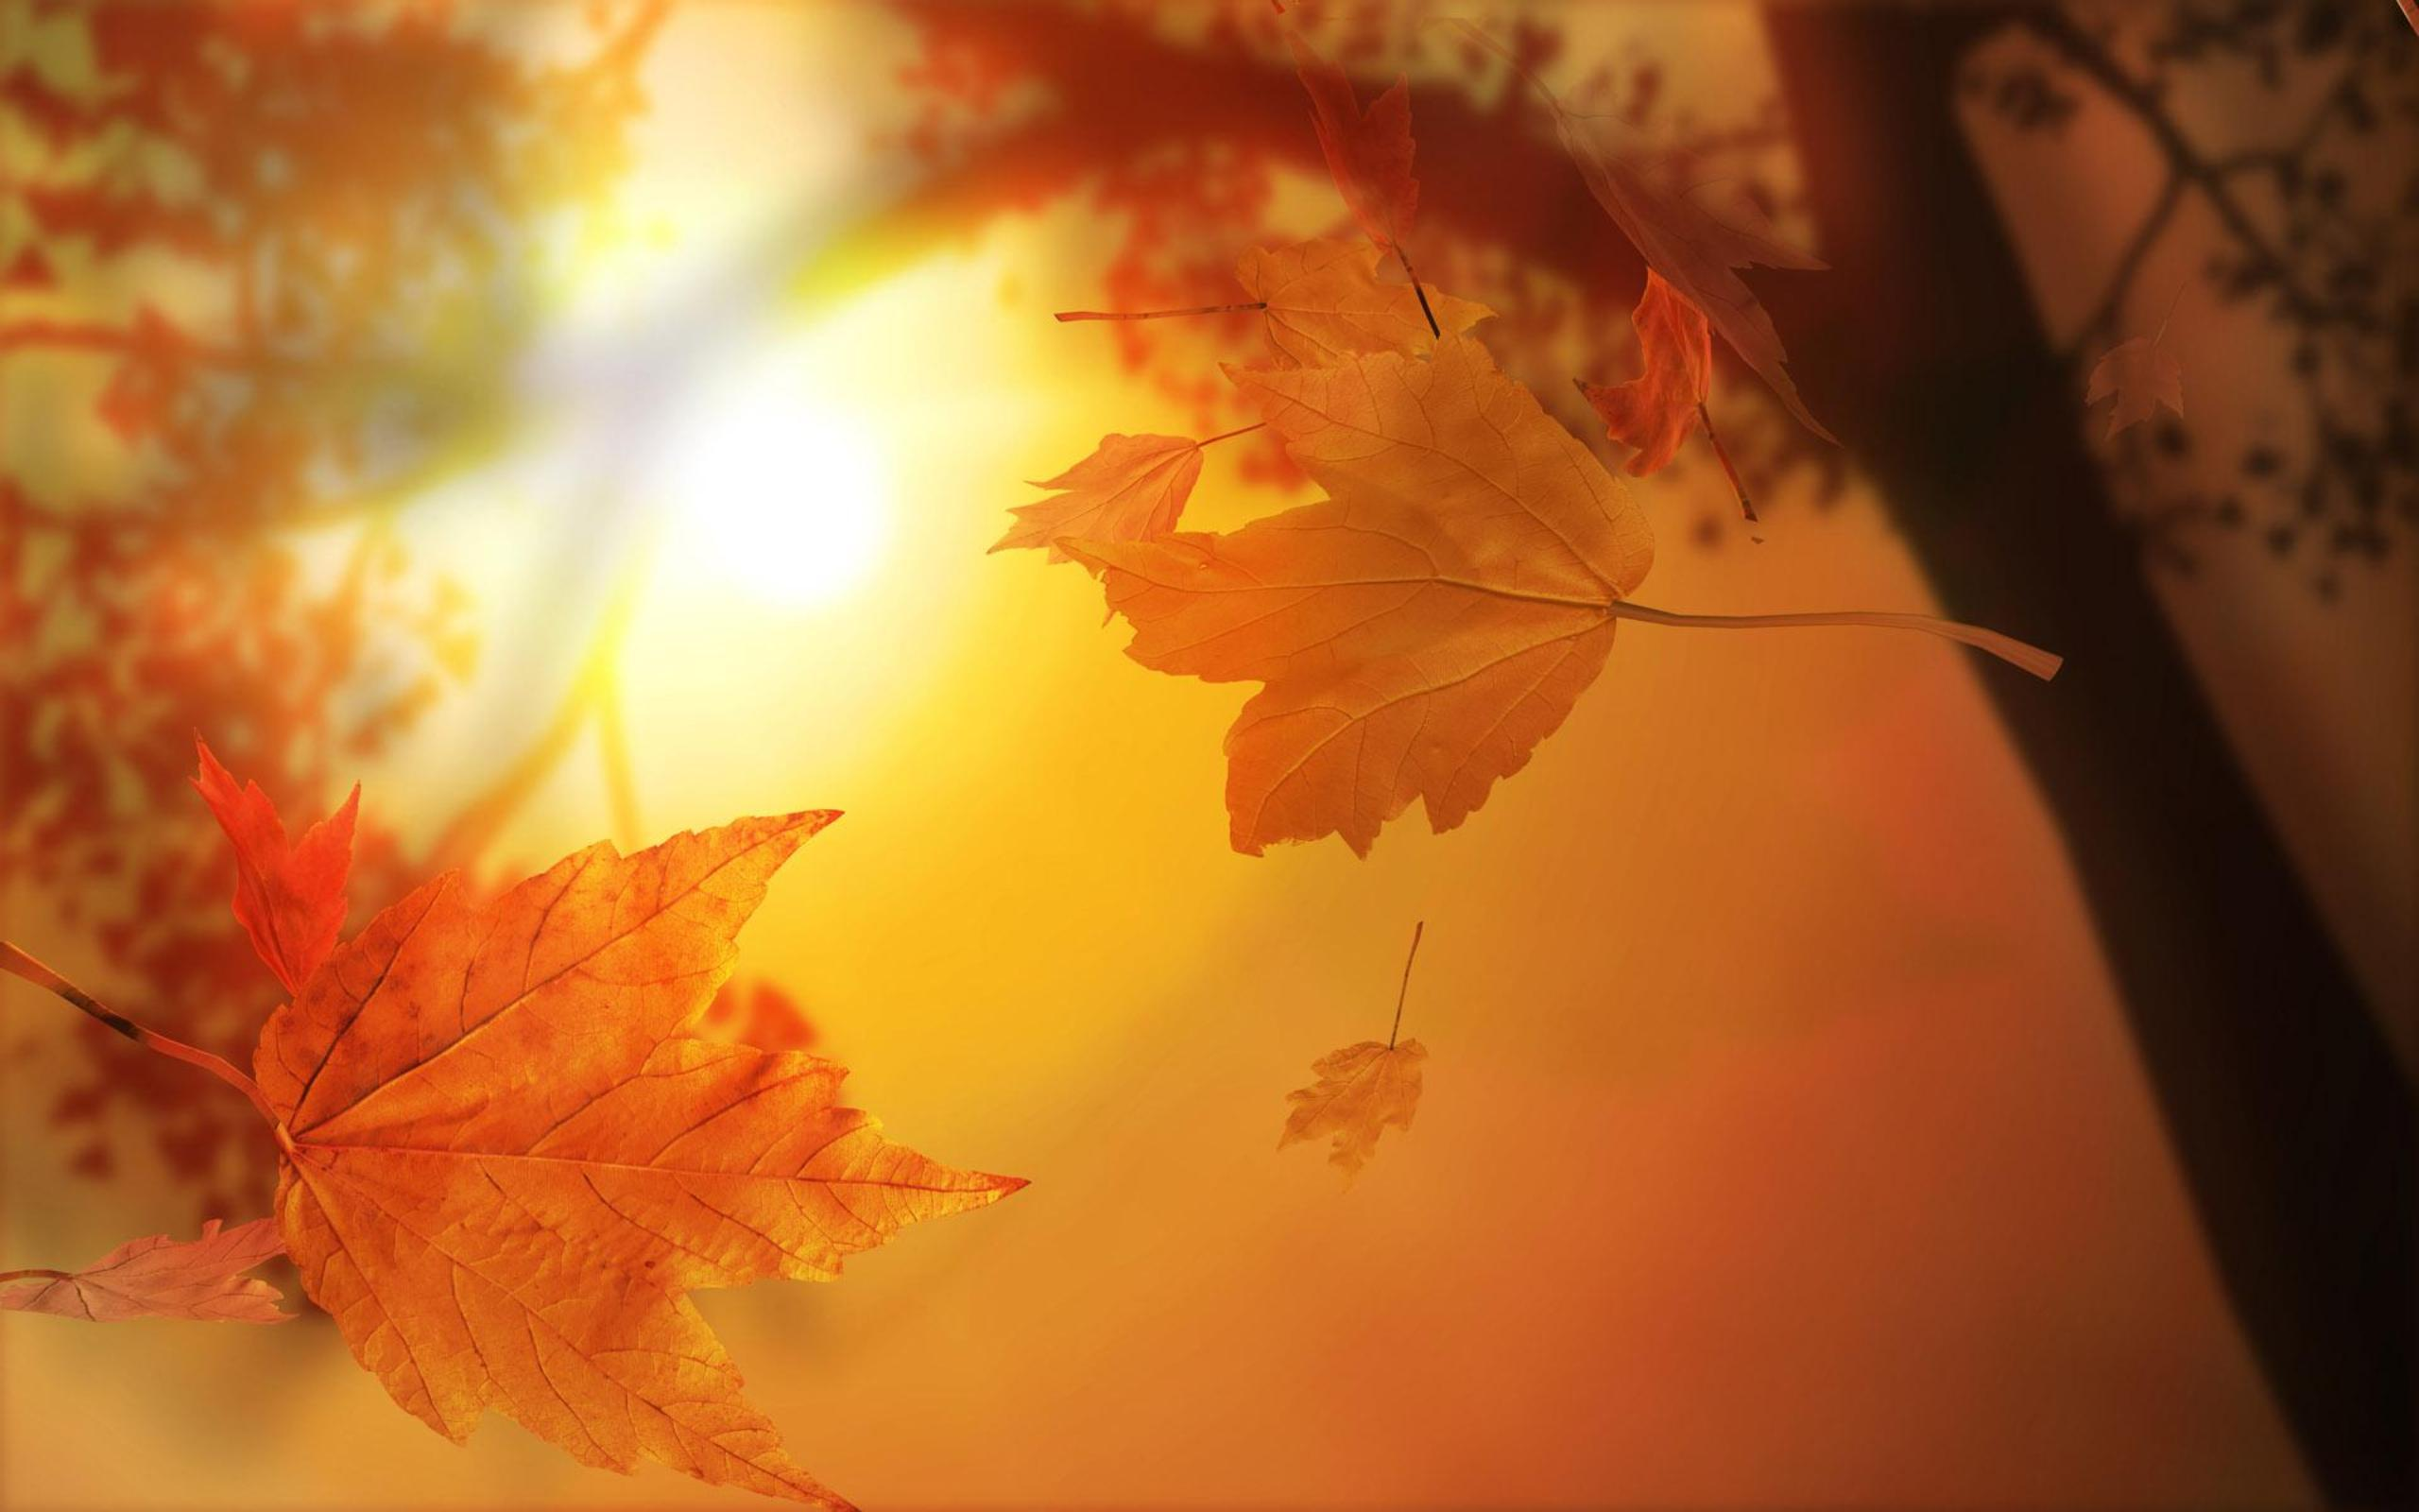
THE CONSTANCY OF Thankfulness

Slide 3
Thanksgiving in Scripture
Eph. 5:4, 19-20 ESV “Let there be no filthiness nor foolish talk nor crude joking, which are out of place, but instead let there be thanksgiving.” “19) addressing one another in psalms and hymns and spiritual songs, singing and making melody to the Lord with your heart, (20) giving thanks always and for everything to God the Father in the name of our Lord Jesus Christ,”

Slide 4
Thanksgiving in Scripture
Phil. 4:6 ESV “do not be anxious about anything, but in everything by prayer and supplication with thanksgiving let your requests be made known to God.”
Col. 2:6-7 ESV“ Therefore, as you received Christ Jesus the Lord, so walk in him, (7) rooted and built up in him and established in the faith, just as you were taught, abounding in thanksgiving.”

Slide 5
Thanksgiving in Scripture
Col. 3:15-17 ESV “ And let the peace of Christ rule in your hearts, to which indeed you were called in one body. And be thankful. (16) Let the word of Christ dwell in you richly, teaching and admonishing one another in all wisdom, singing psalms and hymns and spiritual songs, with thankfulness in your hearts to God. (17) And whatever you do, in word or deed, do everything in the name of the Lord Jesus, giving thanks to God the Father through him.”

Slide 6
One Who Gave Thanks
10 Lepers Lk. 17:11-19
To be a leper was to be cast out of society.
The lepers call out to Jesus.
They acted in faith.

Slide 7
One Who Gave Thanks
One took notice.
He saw that he had been healed.
The beginning of thanksgiving is to recognize what we have. 2Pet. 1:3
Satan wants us to see how bad we have it.
2 Pet. 1:3 “His divine power has given us everything we need for life and godliness through the full knowledge of the one who called us by his own glory and excellence.”
“An unthankful Christian is a defeated Christian because they have lost their joy.” Robert Massey

Slide 8
One Who Gave Thanks
One made gratitude a priority.
He turned back.
Thanksgiving is a priority because of who God is and what He has done. Ps. 118:1
To be a priority means we must show gratitude in every situation. 1 Thess. 5:18
PS. 118:1“Oh give thanks to the LORD, for he is good; for his steadfast love endures forever!”
“When thanksgiving is genuine, it's spontaneous, even involuntary — you recognize you've been blessed and can't help but share your joy through thanksgiving.” David Lose
1 Thess. 5:18 “in everything give thanks; for this is God's will for you in Christ Jesus.”

Slide 9
One Who Gave Thanks
One saw the glory in thanksgiving.
He glorified God.
True thanksgiving is to put self in submission to another and recognize their worth.
To give thanks is to complete what God began. 2 Cor. 4:15
2Cor. 4:15 “For all things are for your sakes, so that the grace which is spreading to more and more people may cause the giving of thanks to abound to the glory of God.”

