Slide 1
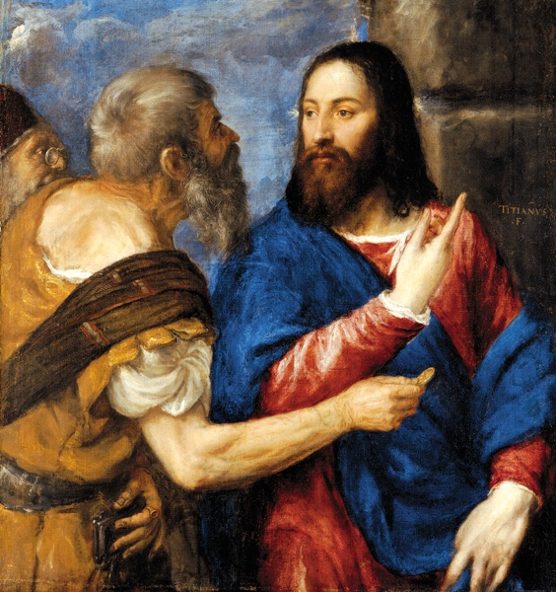
Are You Seeing This?
Matthew 16:21-28

Slide 2
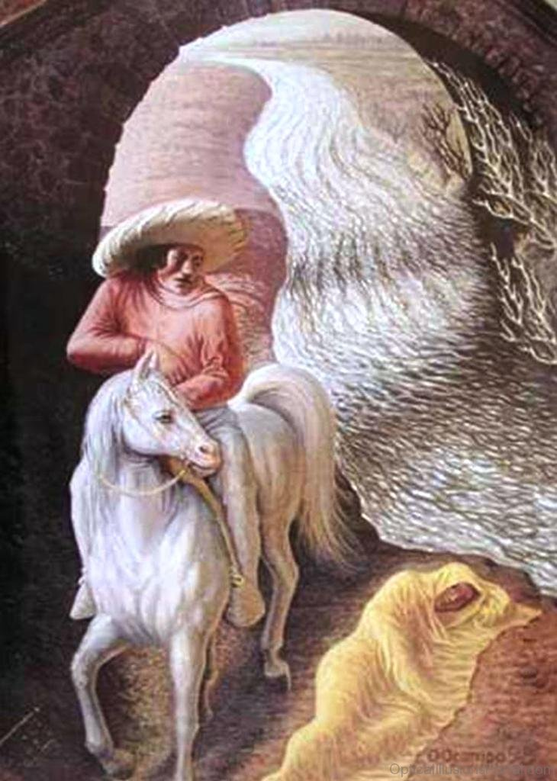

Slide 3
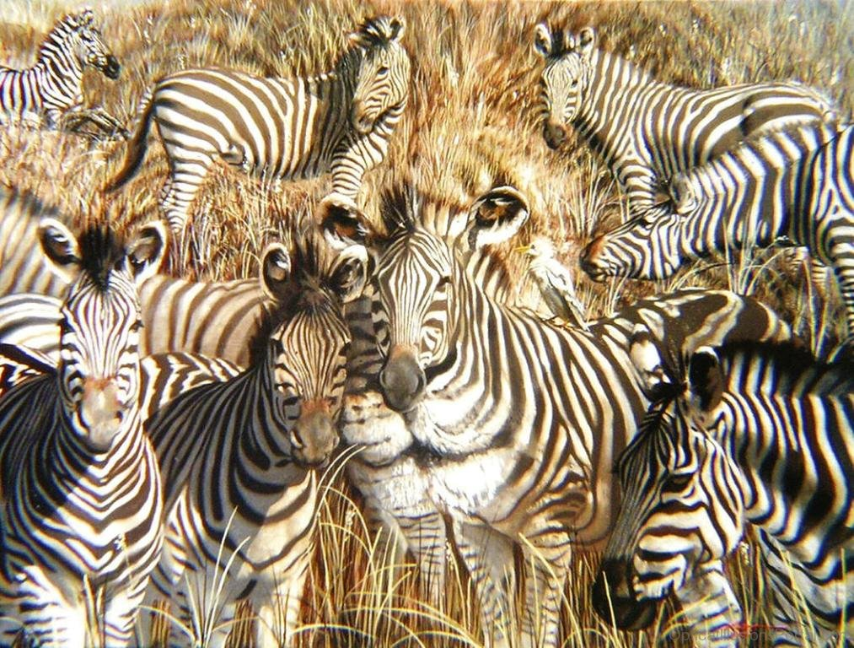

Slide 5
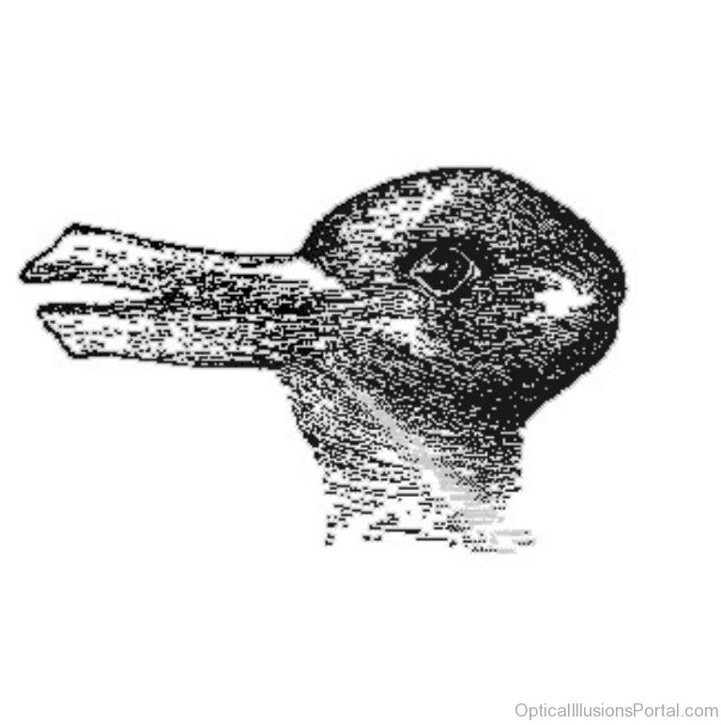

Slide 6
Matthew 16:21-23
Why Did Peter lash out against Jesus?
Peter Knew Who Jesus Was
Matthew 16:13-16, He was the CHRIST!
Peter Didn’t know the Whole story, he imagined a different Ending...
Crushing Military Might
The collapse of Rome

Slide 7
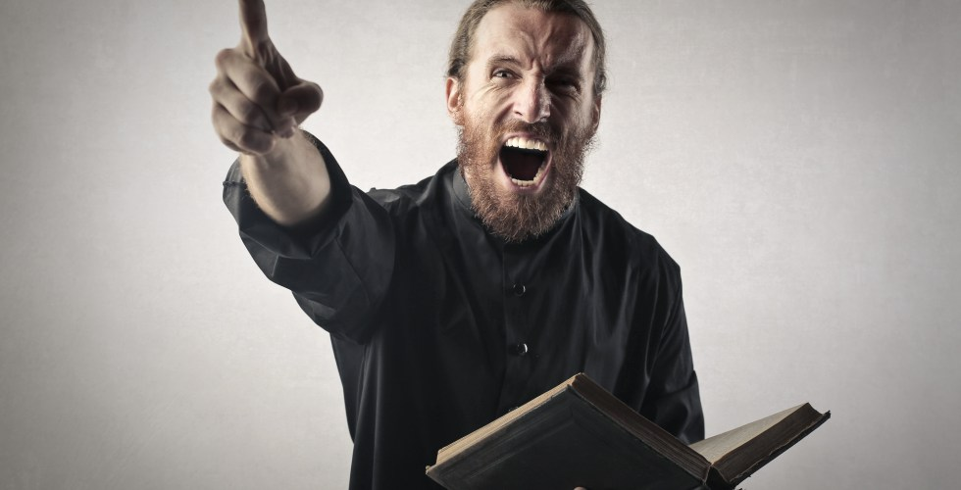
Do We make the same mistake Peter made?
Sometimes we yell at Jesus:
Not Socially Acceptable
Makes us feel uncomfortable
Goes against “our picture”

Slide 8
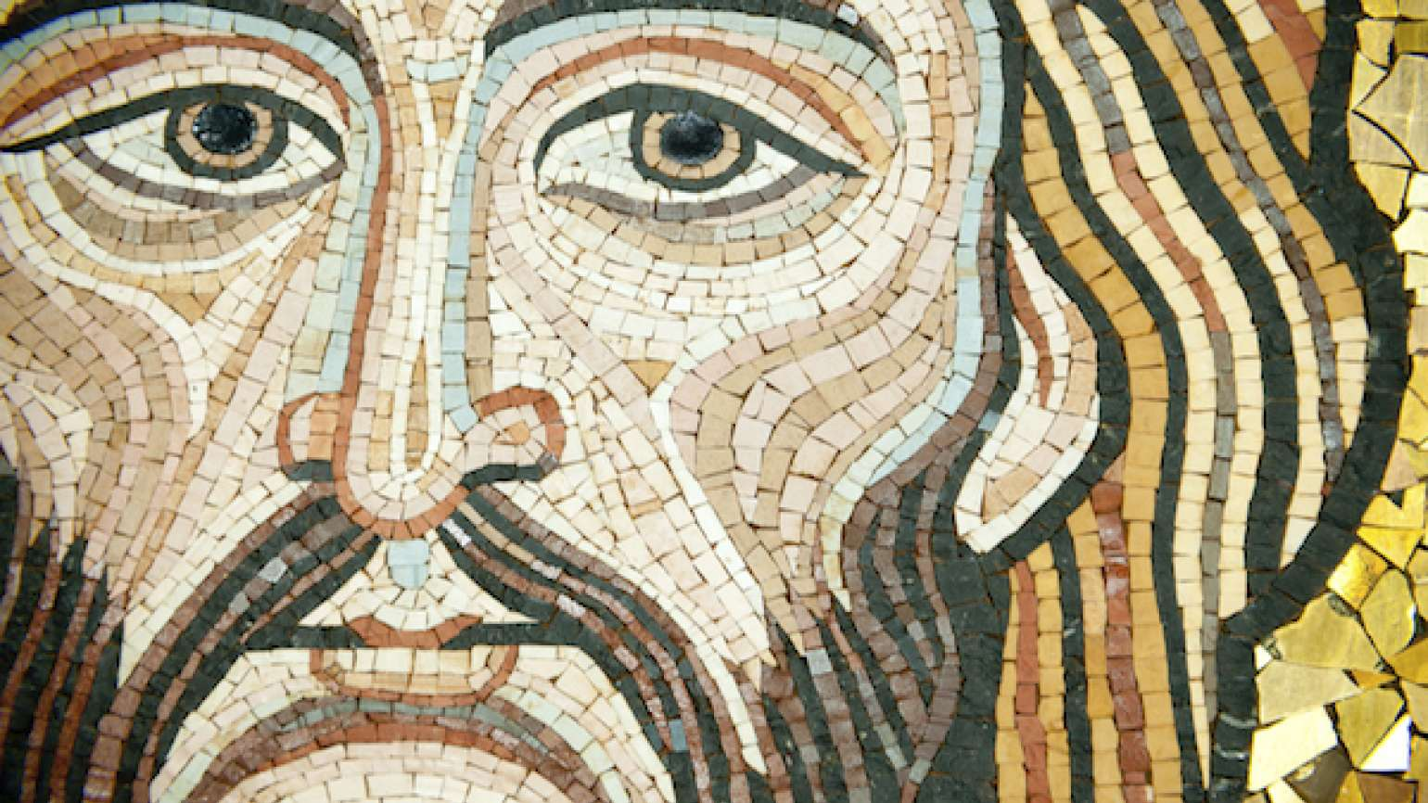
Matthew 16:24-28
Jesus Knew Death was NOT the end
He died in order to bring us life!
Jesus will die, but will WIN!

Slide 9
The Lord’s Supper
Reflection
Realignment
Thanksgiving
“Type a quote here.”
–Johnny Appleseed

