Slide 1
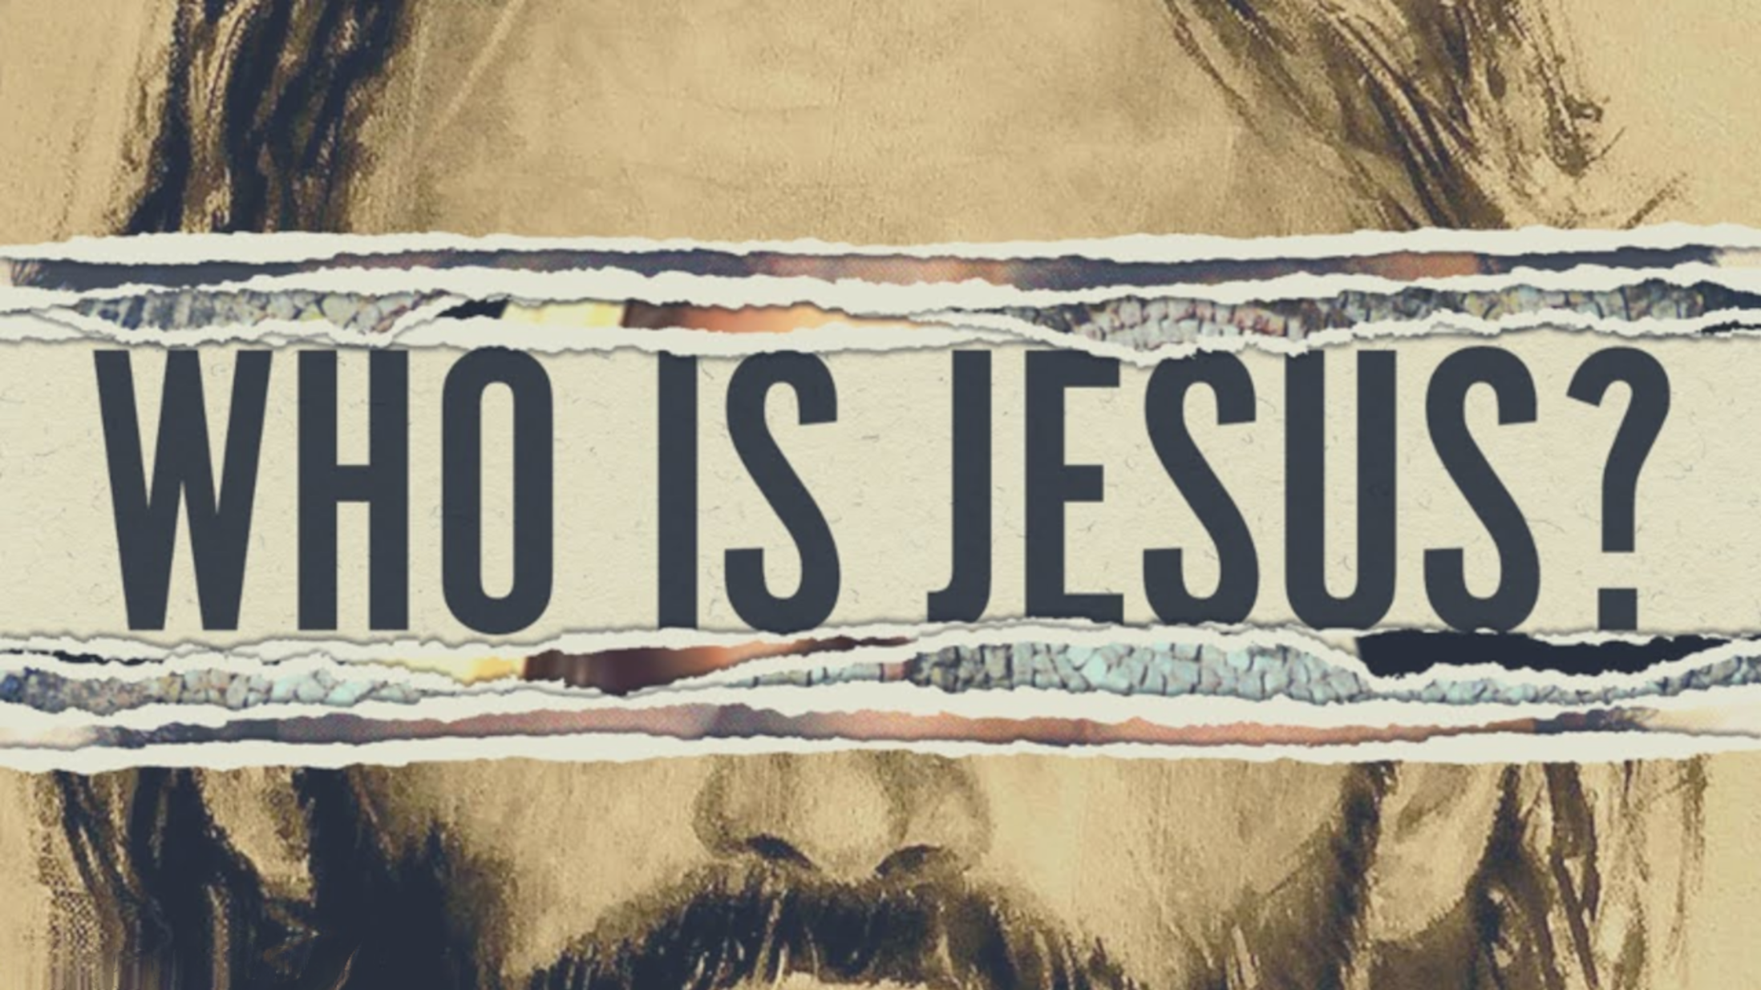

Slide 3
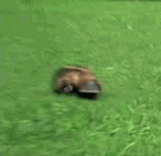
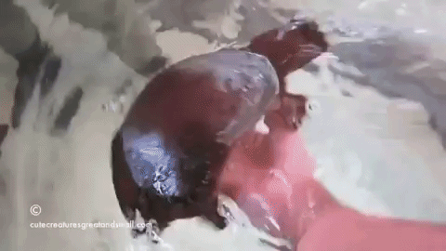
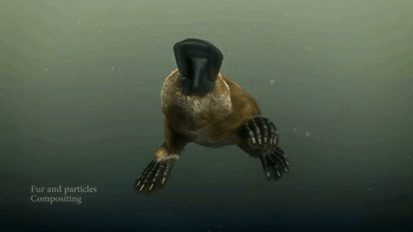

Slide 4
Our Purpose: To see, experience and reflect the glory of God.
God’s glory is His infinite greatness and worth.

Slide 5
John 10:30-33 "I and the Father are one." (31) The Jews picked up stones again to stone Him. (32) Jesus answered them, "I showed you many good works from the Father; for which of them are you stoning Me?" (33) The Jews answered Him, "For a good work we do not stone You, but for blasphemy; and because You, being a man, make Yourself out to be God."

Slide 6
Jn. 20:30-31 Therefore many other signs Jesus also performed in the presence of the disciples, which are not written in this book; (31) but these have been written so that you may believe that Jesus is the Christ, the Son of God; and that believing you may have life in His name.

Slide 7
Who he is
The Word Jn. 1:1-3
We use words to express meaning and communicate with others.
The Word is the Divine expression of God.
“John calls Jesus the Word because he had come to see the words of Jesus as the truth of God and the person of Jesus as the truth of God in such a unified way that Jesus himself — in his coming, and working, and teaching, and dying and rising — was the final and decisive message of God.” John Piper

Slide 8
Who he is
In the beginning Jn. 1:1-3
Back to creation – Gen. 1:1
Before anything came into being the Word existed.
The Word is eternal.

Slide 9
Who he is
The Word was with God. Jn. 1:1-3
The Word had a relationship with God.
“With” denotes friendship, intimacy
God is not unipersonal.
The Word is not the Father.
God is tripersonal.
One God in three persons.

Slide 10
Who he is
The Word was God. Jn. 1:1-3
Jesus, the Word, is the very essence of the all-knowing, all-powerful, all-present divine Being.
He is equal with the Father and Holy Spirit.
He was not created but the Creator.

Slide 11
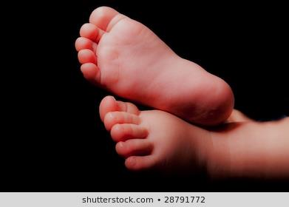
WHAT HE DID
The Word became flesh. Jn. 1:14
God became man and took on human nature.
Phil. 2:6-7 “who, although He existed in the form of God, did not regard equality with God a thing to be grasped, (7) but emptied Himself, taking the form of a bond-servant, and being made in the likeness of men.”

Slide 12
WHAT HE DID
He dwelt among us. Jn. 1:14
Dwelt – tabernacled – pitched his tent.
It implies that God wanted to be on familiar terms with us.

Slide 13
WHAT HE DID
We beheld His glory. Jn. 1:14
Jesus’ incarnation showed us the glory of God.
God came down to His creation.
Jesus is the exact representation of God.
Col. 1:15 “He is the image of the invisible God,…”
Jn. 14:9 “Have I been so long with you, and yet you have not come to know Me, Philip? He who has seen Me has seen the Father; how can you say, 'Show us the Father'?”

Slide 14
Heb 1:1-3a God, after He spoke long ago to the fathers in the prophets in many portions and in many ways, (2) in these last days has spoken to us in His Son, whom He appointed heir of all things, through whom also He made the world. (3) And He is the radiance of His glory and the exact representation of His nature,

Slide 15
THE IMPORTANCE TO US
Jesus is the way.
We exchanged God’s glory for another.
The consequence of sin is death.
Jesus is the only way back to God.
Jn. 14:6 “I am the way, and the truth, and the life; no one comes to the Father but through Me.”

Slide 16
THE IMPORTANCE TO US
An infinite payment
Jesus had to be God to pay our penalty.
Only an infinite God could pay such an infinite penalty.
Eternal life
The ultimate proof of His deity is His resurrection.
In defeating death we can have eternal life in God’s presence.

