Slide 1
Boast in the Lord!

Slide 2
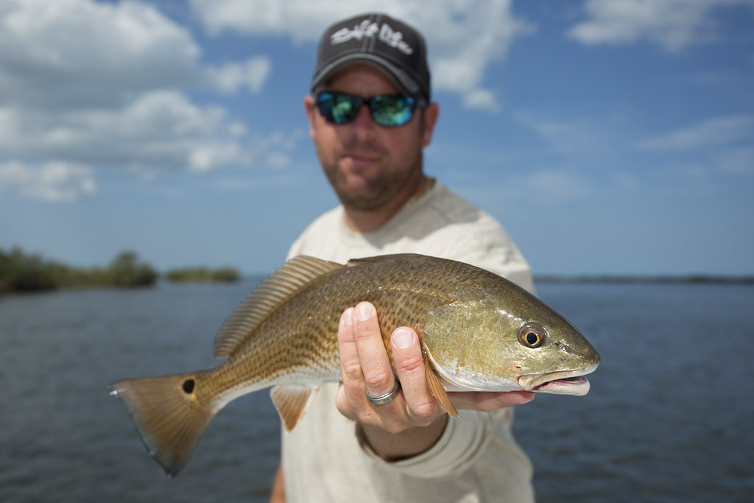
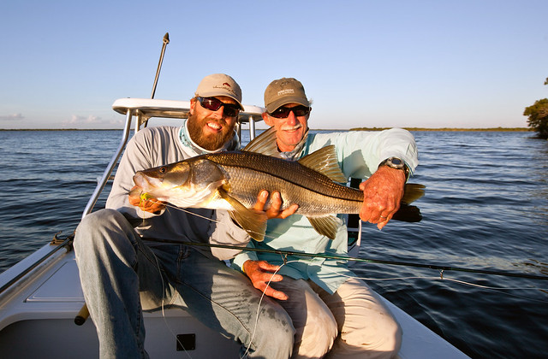
Fish Boast’n!
My fish was sooooooo big

Slide 3
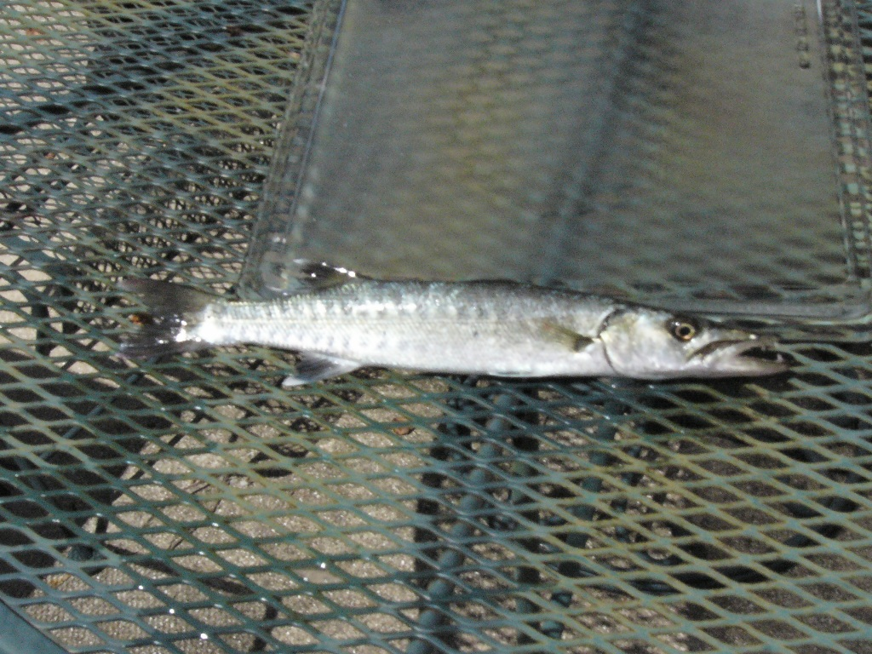
Fish Boast’n
My fish was sooooooo big!

Slide 4
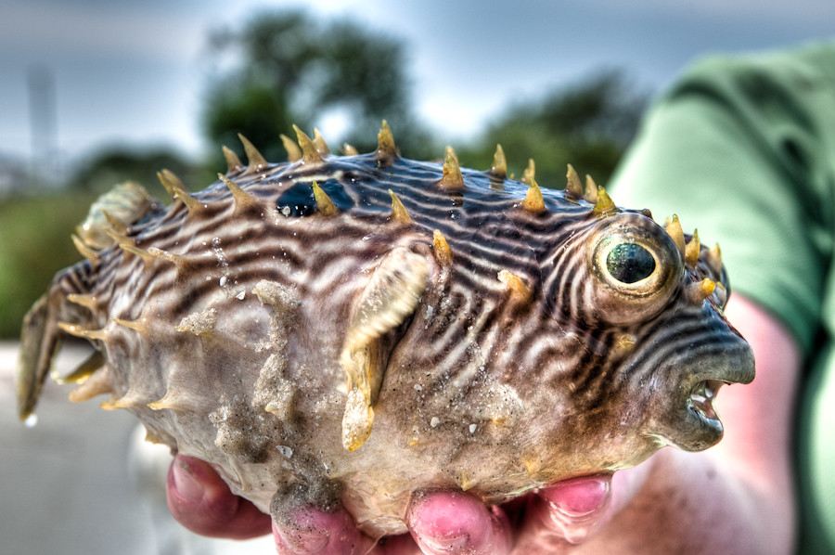
Puffed Up Florida Puffer Fish

Slide 5
Humans boast in…
Strength
Intelligence
Beauty
Riches
Inventions
Arts
Athletics

Slide 6
God’s word on boasting…
“23 Thus says the Lord, ‘Let not a wise man boast of his wisdom, and let not the mighty man boast of his might, let not a rich man boast of his riches; 24 but let him who boasts boast of this, that he understands and knows Me, that I am the Lord who exercises lovingkindness, justice and righteousness on the earth; for I delight in these things,’ declares the Lord.” (Jeremiah 9:23-24)

Slide 7
Writing about the wisdom of God shown in the message of Christ crucified, Paul wrote…
“ 37 but God has chosen the foolish things of the world to shame the wise, and God has chosen the weak things of the world to shame the things which are strong, 28 and the base (the low born, untouchables) things of the world and the despised God has chosen, the things that are not, so that He may nullify the things that are, 29 so that no man may boast before God. ”
(1 Corinthians 1:37-39)

Slide 8
“ 30 But by His doing you are in Christ Jesus, who became to us wisdom from God, and righteousness and sanctification, and redemption, 31 so that, just as it is written, “ Let him who boasts, boast in the Lord.’”
(1 Corinthians 1:30-31)

Slide 9
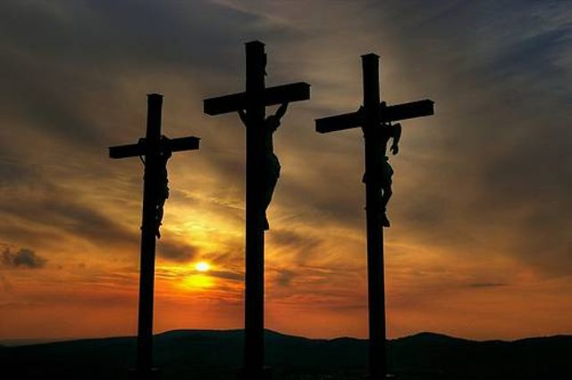
Salvation in Jesus Christ is…
Wisdom from God! (1 Corinthians 1:23-24)
Our basis righteousness!
Our basis of sanctification!
Our basis of redemption!

Slide 10
Boast in the cross of our Lord Jesus Christ…
“12 Those who desire to make a good showing in the flesh, try to compel you to be circumcised, simply so that they will not be persecuted for the cross of Christ. 13 For those who are circumcised do not even keep the Law themselves, but they desire to have you circumcised so that they may boast in your flesh.” (Galatians 6:12-13)

Slide 11
Boast in the cross of our Lord Jesus Christ…
“14 But may it never be that I would boast, except in the cross of our Lord Jesus Christ, through which the world has been crucified to me, and I to the world. 15 For neither is circumcision anything, nor uncircumcision, but a new creation.” (Galatians 6:14-15)

Slide 12
What are we doing in the Lord’s supper?
Remembering His body sacrificed for us
Remembering His blood shed for our sins
Focusing on the amazing love and grace of God
Boasting in the cross of our Lord Jesus Christ!
He is our wisdom from God, our righteousness, sanctification and redemptions

Slide 13
Boast in the Lord!

