Slide 2
What is our purpose?
Where did we come from?
Where are we going?

Slide 3
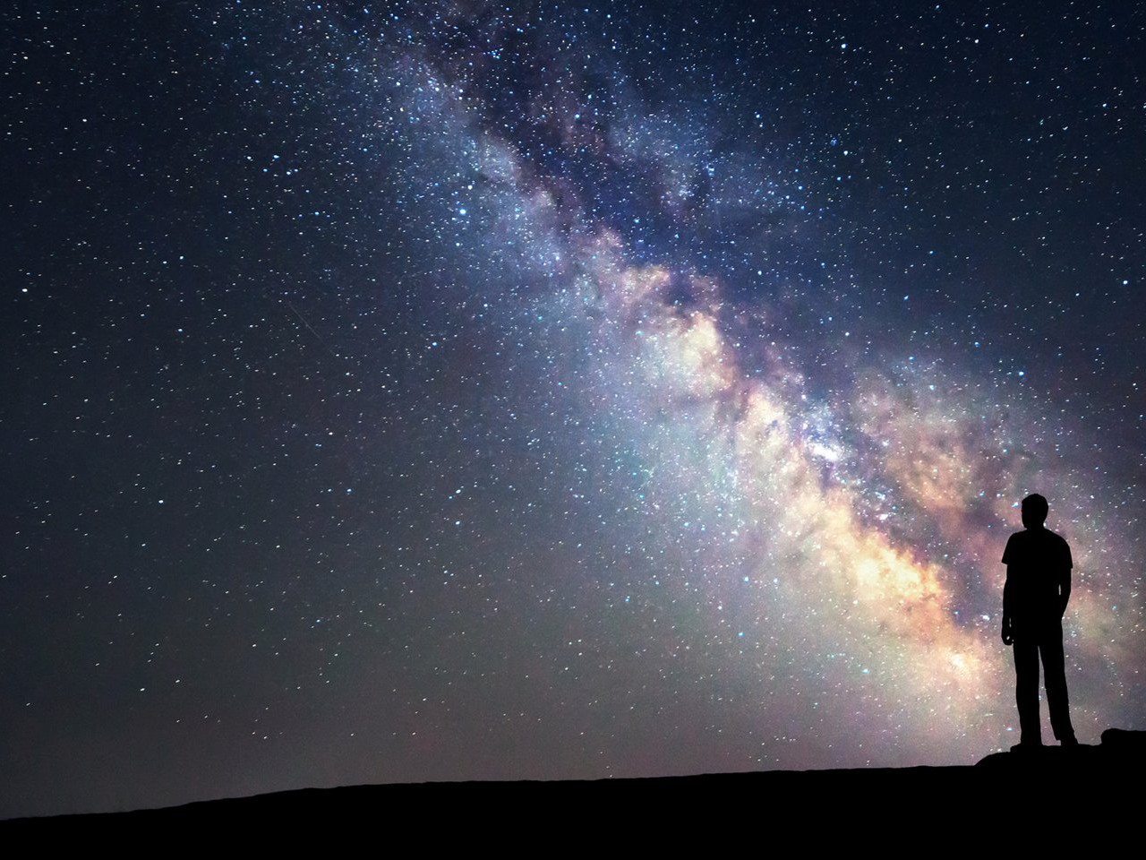
Made for glory
There is God.
The is an all-powerful, all-knowing, all-present Being who is self-existent.
God’s ultimate goal is to preserve and display His infinite and awesome greatness and worth.
Ps. 90:2 “Before the mountains were brought forth, or ever you had formed the earth and the world, from everlasting to everlasting you are God.”
Isa. 40:28 “Have you not known? Have you not heard? The LORD is the everlasting God, the Creator of the ends of the earth. He does not faint or grow weary; his understanding is unsearchable.”

Slide 4
Made for glory
The universe was created for God’s glory.
The created universe displays His glory.
Ps. 19:1 “The heavens are telling of the glory of God; And their expanse is declaring the work of His hands.”

Slide 5
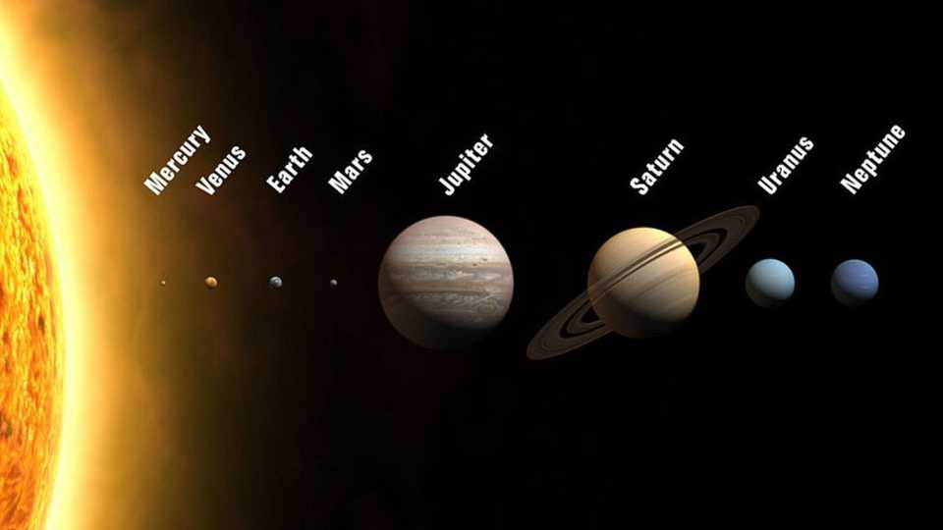

Slide 6
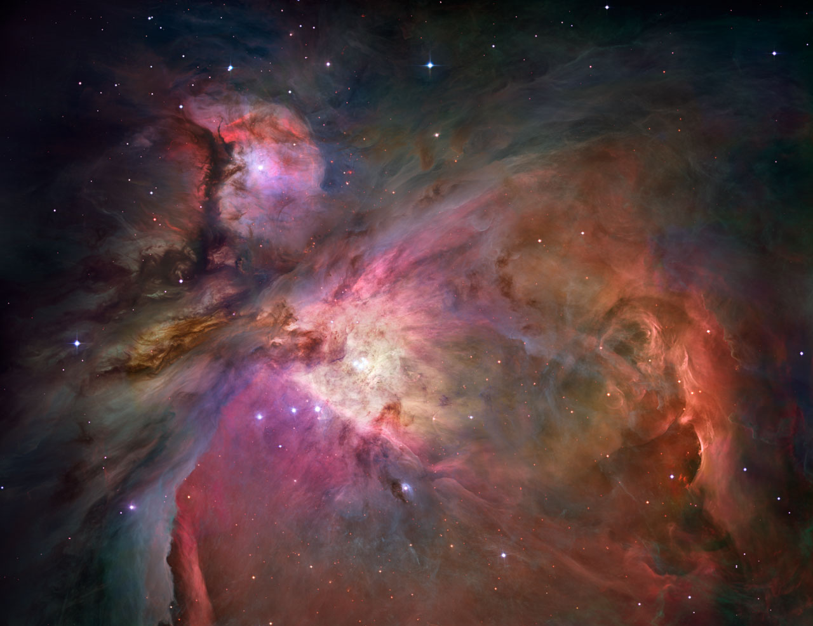
Isa. 40:26 “Lift up your eyes on high And see who has created these stars, The One who leads forth their host by number, He calls them all by name; Because of the greatness of His might and the strength of His power, Not one of them is missing.”

Slide 7
Made for glory
God’s glory is our deepest longing.
We were made to experience His glory.
God wants us to share in His glory because He is the greatest good.
Isa. 43:6-7 "… Bring My sons from afar And My daughters from the ends of the earth, (7) Everyone who is called by My name, And whom I have created for My glory, Whom I have formed, even whom I have made."
Rom. 9:23 “And He did so to make known the riches of His glory upon vessels of mercy, which He prepared beforehand for glory,”

Slide 8
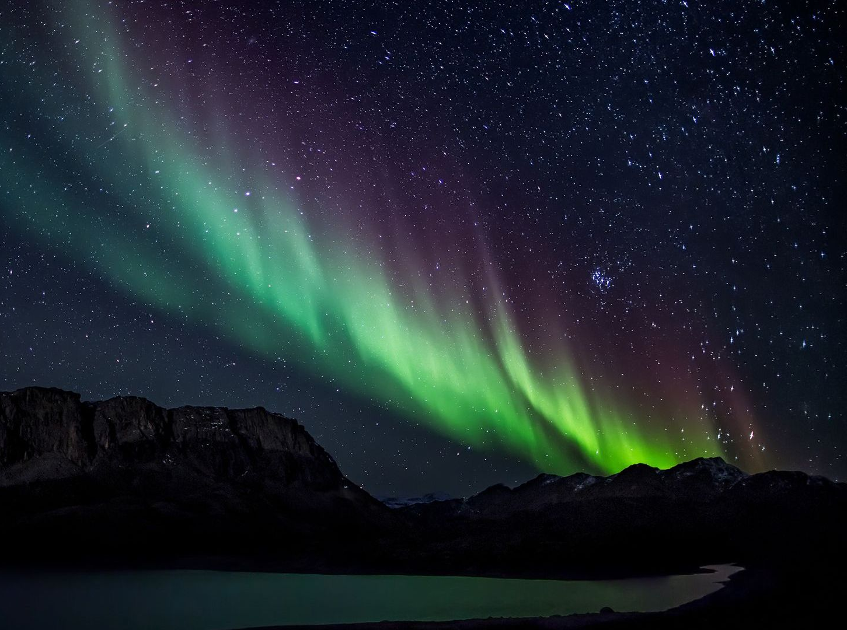
“I had not noticed either that just as men spontaneously praise whatever they value, so they spontaneously urge us to join them in praising it: “Isn’t she lovely? Wasn’t it glorious? Don’t you think that magnificent?” The Psalmists in telling everyone to praise God are doing what all men do when they speak of what they care about. My whole, more general, difficulty about the praise of God depended on my absurdly denying to us, as regards the supremely Valuable, what we delight to do, what indeed we can’t help doing, about everything else we value. I think we delight to praise what we enjoy because the praise not merely expresses but completes the enjoyment; it is its appointed consummation. It is not out of compliment that lovers keep on telling one another how beautiful they are; the delight is incomplete till it is expressed. . . . The Scotch catechism says that man’s chief end is ‘to glorify God and enjoy Him forever.’ But we shall then know that these are the same thing. Fully to enjoy is to glorify. In commanding us to glorify Him, God is inviting us to enjoy Him.” C.S. Lewis

Slide 9
Made for glory
God’s glory is our deepest longing.
We were made to experience His glory.
God wants us to share in His glory because He is the greatest good.
We praise what we enjoy because the delight is incomplete until it is expressed in praise.
1Cor. 10:31 So, whether you eat or drink, or whatever you do, do all to the glory of God.

Slide 10
Our Problem
We exchanged the glory.
We have the choice to display God’s glory or something else.
We traded God’s glory for images and everything is in disorder.
Rom. 1:22-23 “Professing to be wise, they became fools, (23) and exchanged the glory of the incorruptible God for an image in the form of corruptible man and of birds and four-footed animals and crawling creatures.”

Slide 11
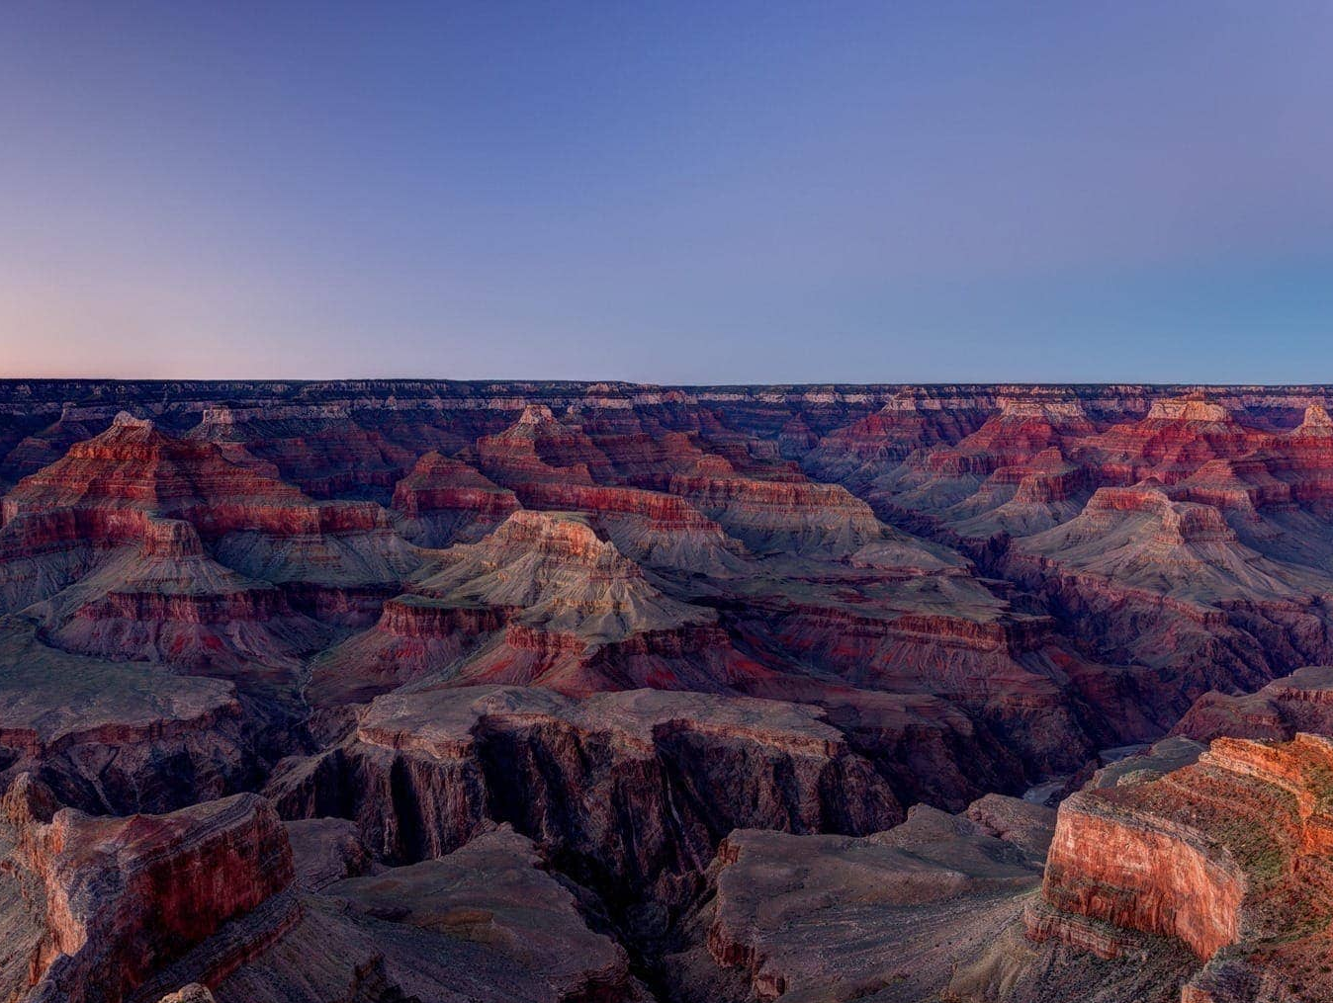
“We are all starved for the glory of God, not self. No one goes to the Grand Canyon to increase self-esteem. Why do we go? Because there is greater healing for the soul in beholding splendor than there is in beholding self. Indeed, what could be more ludicrous in a vast and glorious universe like this than a human being, on the speck called earth, standing in front of a mirror trying to find significance in his own self-image? It is a great sadness that this is the gospel of the modern world.” John Piper

Slide 12
Our Problem
We exchanged the glory.
God didn’t leave us to stay in this disorder.
Rom. 9:22-23 “What if God, although willing to demonstrate His wrath and to make His power known, endured with much patience vessels of wrath prepared for destruction? (23) And He did so to make known the riches of His glory upon vessels of mercy, which He prepared beforehand for glory,”

Slide 13
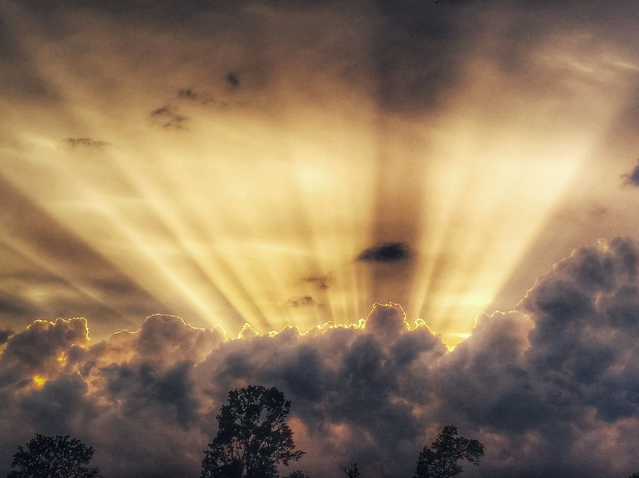
God’s solution
God’s Story
God desired a family.
He sent His Son, Jesus Christ, into our world to live among us and die for us.
What is the most loving thing Jesus could do for us?
It’s all about God’s glory.
Jn. 17:24 “Father, I desire that they also, whom You have given Me, be with Me where I am, so that they may see My glory which You have given Me, for You loved Me before the foundation of the world.”
2 Cor. 4:4,6 “in whose case the god of this world has blinded the minds of the unbelieving so that they might not see the light of the gospel of the glory of Christ, who is the image of God. 6) For God, who said, "Light shall shine out of darkness," is the One who has shone in our hearts to give the Light of the knowledge of the glory of God in the face of Christ.”

Slide 14
2 Cor. 3:18 “And we all, with unveiled face, beholding the glory of the Lord, are being transformed into the same image from one degree of glory to another. For this comes from the Lord who is the Spirit.”

