Slide 1
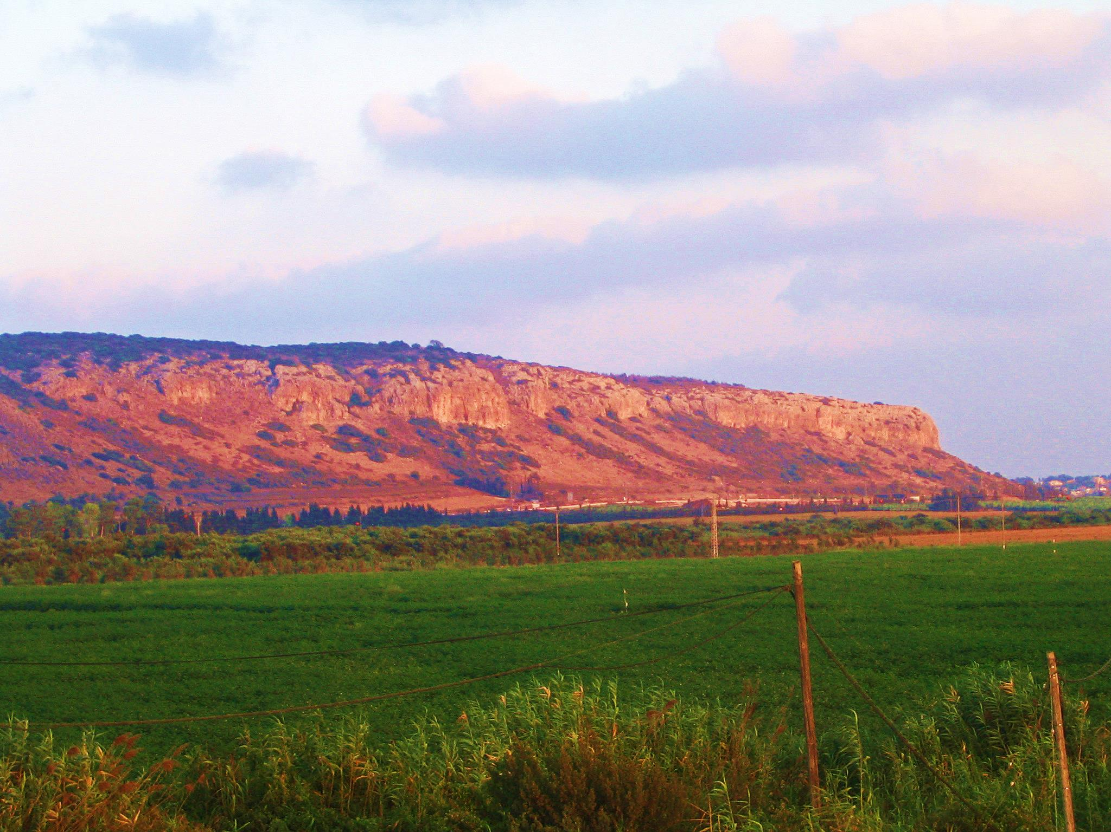

Slide 2
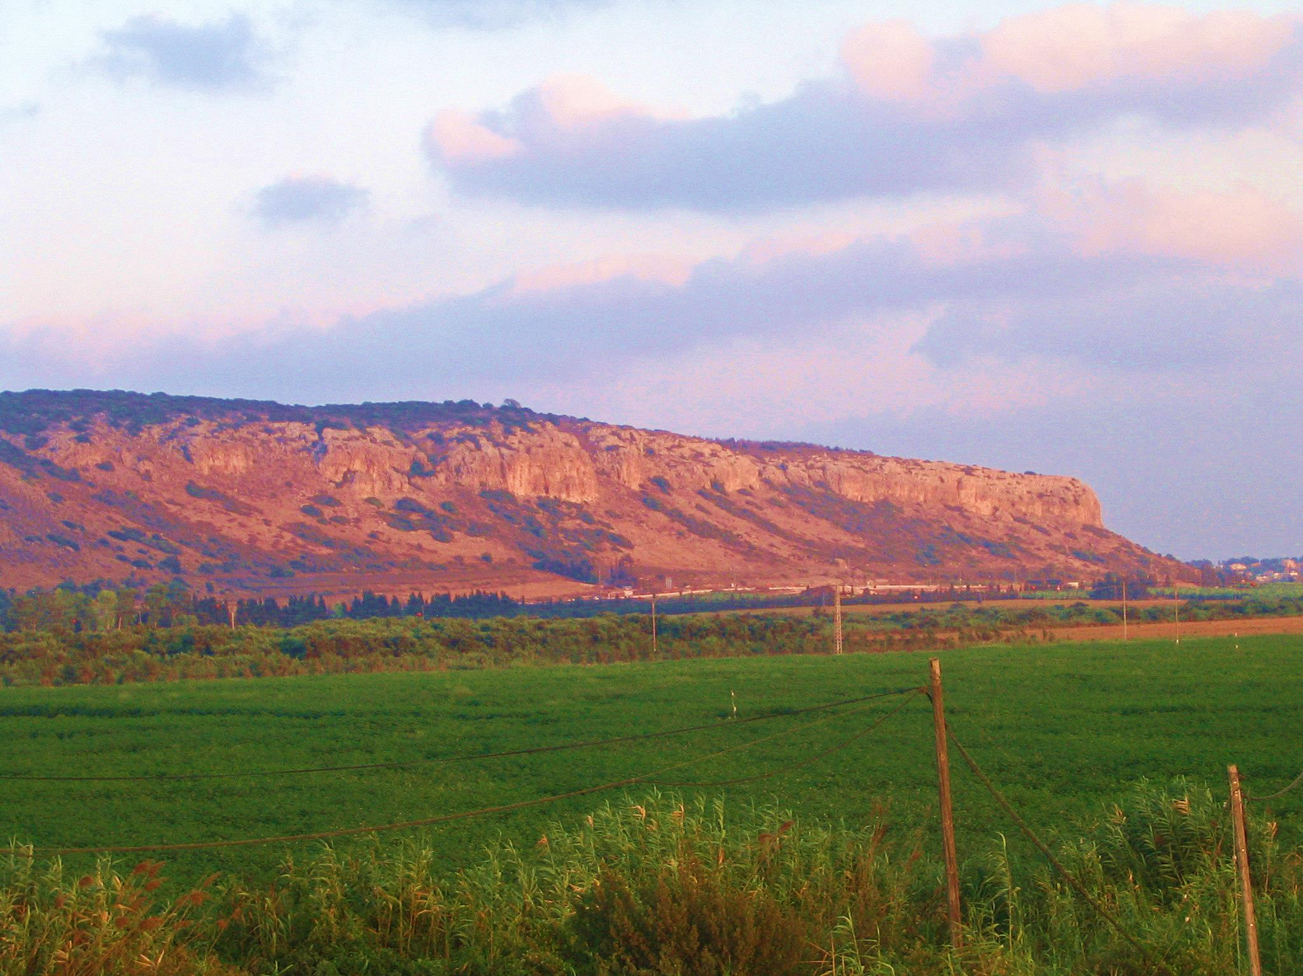
Elijah comes on the scene
A world of multiple gods
Ahab and Jezebel are ruling the northern kingdom of Israel.
Baal worship is the state religion.
Elijah’s mission is to turn the hearts of the people back to God.
A God contest on Mt. Carmel
1Kings 18:46 “then the hand of the Lord was on Elijah and he girded up his loins and outran Ahab to Jezreel.”

Slide 3
Elijah comes on the scene
Elijah runs off v3-4
He flees to Beersheba and then to the desert.

Slide 4
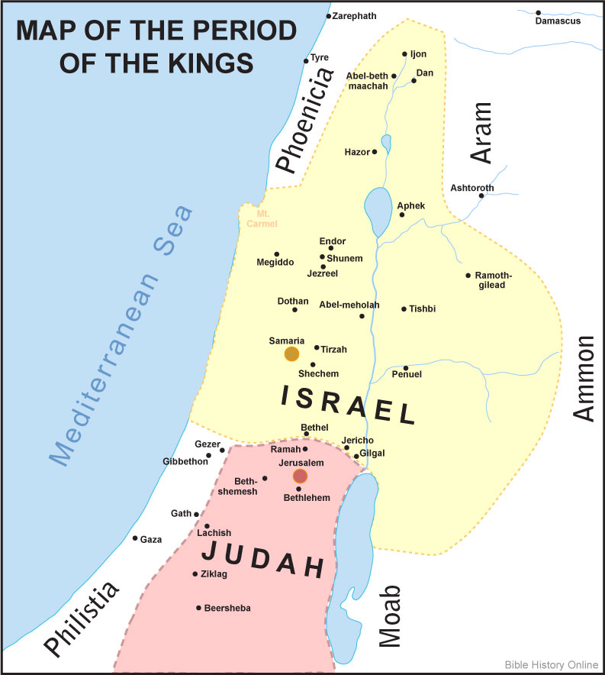

Slide 5
Elijah comes on the scene
Elijah runs off v3-4
He flees to Beersheba and then to the desert.
He is giving up.
Elijah was fleeing for his life and now he wants to give it up.

Slide 6
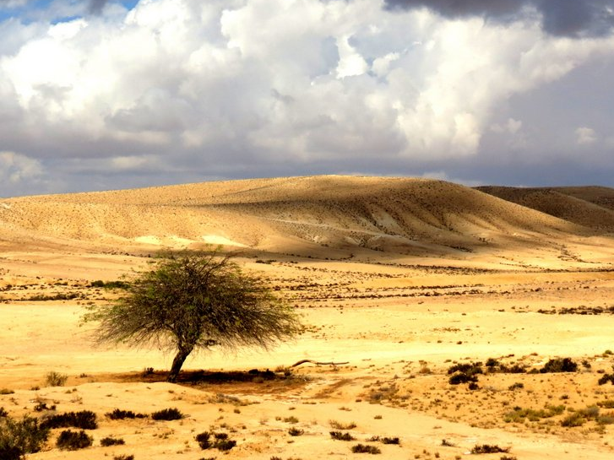
God comes
God meets Elijah where he is. v5-10
He sends the angel of the Lord to bring Elijah food.
God listens – “What are you doing here, Elijah?”
He sends Elijah on a journey – 40 days of solitude.

Slide 7
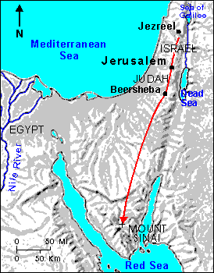

Slide 8
God comes
God meets Elijah where he is. v5-10
He sends the angel of the Lord to bring Elijah food.
God listens – “What are you doing here, Elijah?”
He sends Elijah on a journey – 40 days of solitude.
God deals with all the facets of Elijah’s problem (physical, emotional, spiritual).

Slide 9
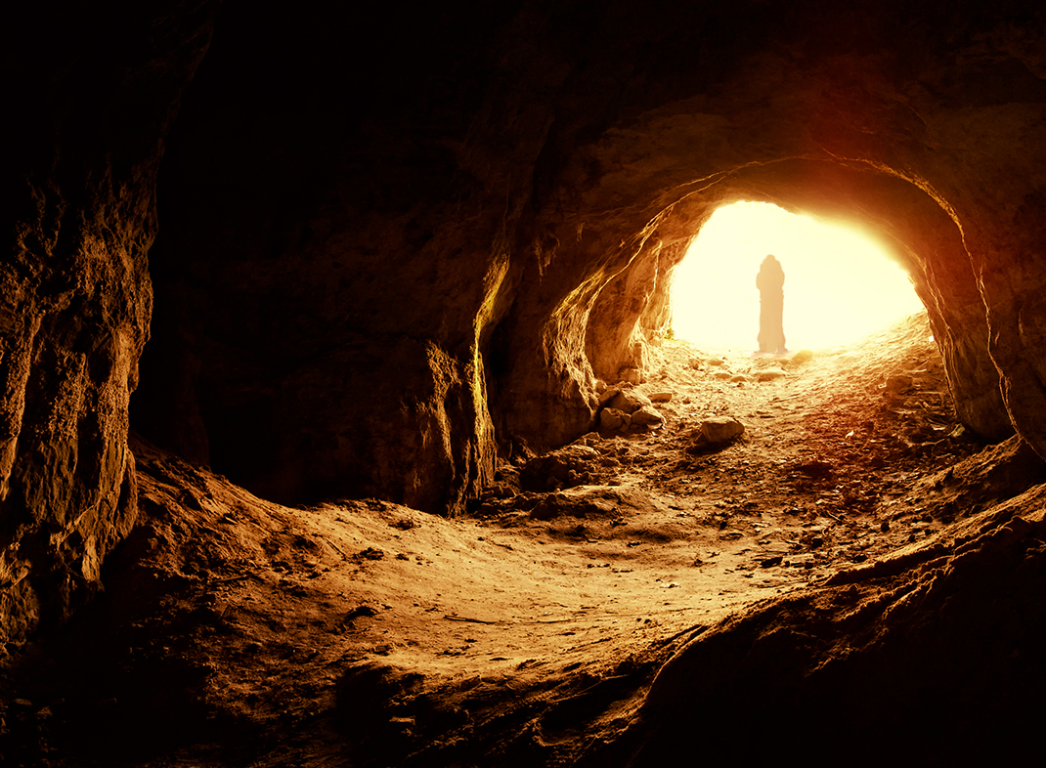
God comes
God comes in unexpected ways v11-18
Elijah comes to Mt. Horeb (Mt. Sinai)
God will pass by Elijah as He passed by Moses.
God’s manifestations
The wind, earthquake, fire
A gentle blowing (still small voice)

Slide 10
God comes
Elijah’s despair
He put God in a box – I had the right plan.
Elijah’s plan failed and he became despondent.
He put God in a box – I’m the only one left.
Despair comes from our own narrow mindedness.
God’s plan will always be immeasurably beyond what we can think or see.

Slide 11
God comes
He comes in a word of grace.
Why a gentle whisper?
Elijah needed to learn something.
Don’t get caught up in the spectacular.
What penetrates and changes people’s hearts is God’s voice, His word.
Luke 16:31 “But he said to him, 'If they do not listen to Moses and the Prophets, they will not be persuaded even if someone rises from the dead.'"

Slide 12
God comes
He comes in a word of grace.
Not in power but grace.
Elijah was not overwhelmed by the wind, earthquake and fire.
The rock endured their force.
Jesus is the rock that endured the judgment of our sin.

