Slide 2
Choosing to believe that God exists is a voluntary act of trust. We believe not because we think the reality of God is absolutely unequivocal, but because we judge the evidence to be greatly in its favor. After careful thought, faith puts its trust and confidence in a premise that is seen to be supported by the weight of the evidence. Faced with the ultimate fork in the road, faith understands that a decision must be made, and it responsibly chooses one alternative.” Gary Henry

Slide 3
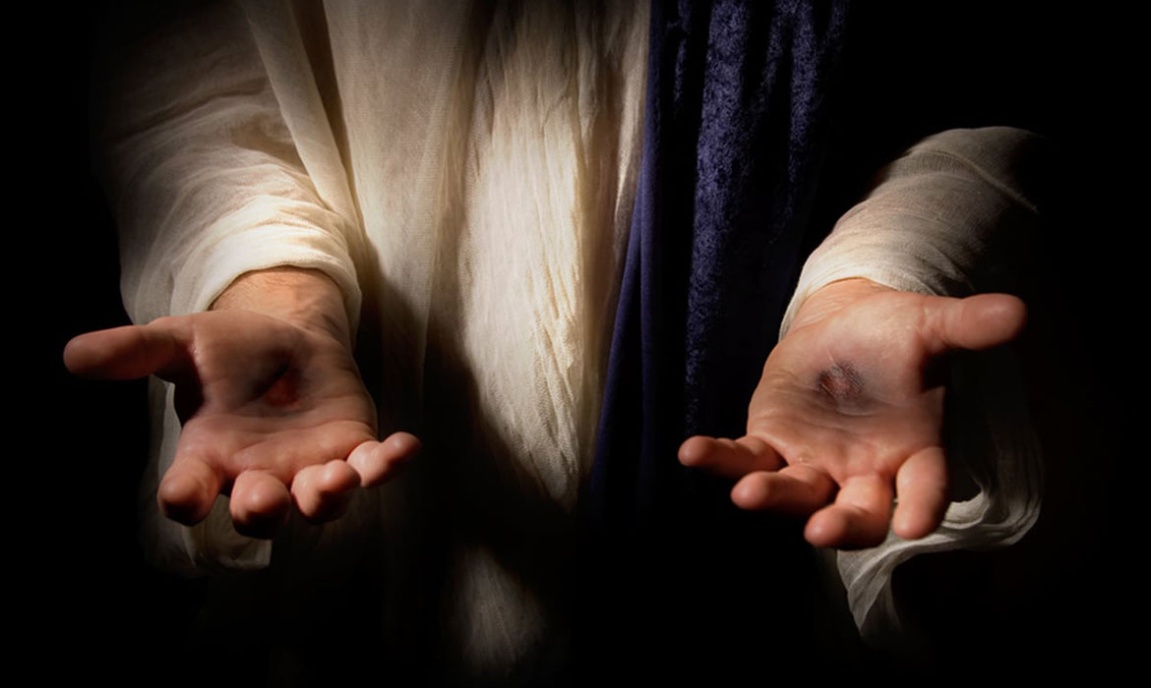
Believing Thomas

Slide 4
Thomas
Disciple.
He is loyal to Jesus. Jn. 11:16
He is not afraid to ask questions. Jn. 14:5
He seems to have a heart to follow.
Jn. 11:16 “So Thomas, called the Twin, said to his fellow disciples, "Let us also go, that we may die with him.”
Jn.14:5 “Lord, we do not know where You are going, how do we know the way?"

Slide 5
Thomas
Doubter. Jn. 20:24-31
The disciples have seen the events of the crucifixion.
3 days later they hear news of Jesus’ resurrection.
The women see the empty tomb and the angels.
Peter and John see the tomb and burial clothes.
That evening Jesus appears to the disciples.
Except Thomas is not there.

Slide 6
Thomas
Doubter. Jn. 20:24-31
Thomas doesn’t just doubt but won’t believe Jesus has risen.
Why did John include this? v30
This event is the greatest declaration of who Jesus is by a man.

Slide 7
Thomas
Believer. Jn. 20:24-31
Jesus appears again to the disciples 1 week later.
Jesus rebukes Thomas.
You didn’t need to see to believe.
As an apostle Thomas needed to see Jesus alive.
My Lord and My God.

Slide 8
Faith builders
Listen to the eyewitnesses.
Jesus rebukes Thomas for not listening to the disciples.
We have the apostles’ eyewitness accounts to believe.
1Jn.1:1-3 ESV “That which was from the beginning, which we have heard, which we have seen with our eyes, which we looked upon and have touched with our hands, concerning the word of life-- (2) the life was made manifest, and we have seen it, and testify to it and proclaim to you the eternal life, which was with the Father and was made manifest to us-- (3) that which we have seen and heard we proclaim also to you, so that you too may have fellowship with us; and indeed our fellowship is with the Father and with his Son Jesus Christ.”

Slide 9
Faith builders
Jesus is seeking you.
Jesus addressed Thomas with his own words.
Jesus was listening to what Thomas had said.
He knew all of his fears and doubts and met Thomas where he was.
Jesus knows us and loves us.
He knows what you hide from everyone and still loves you.

Slide 10
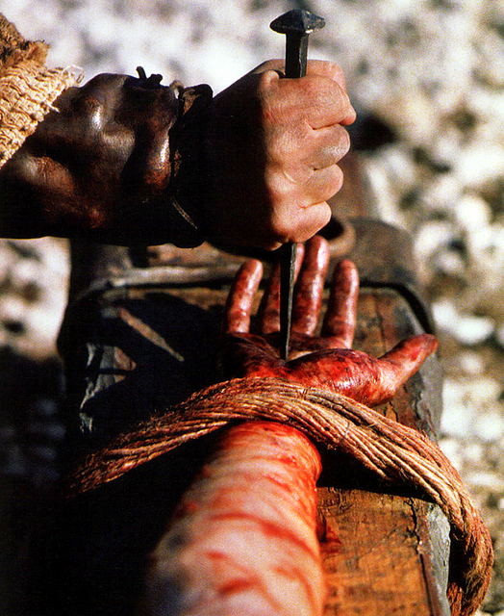
Faith builders
Look at His wounds.
Thomas thought Jesus’ wounds were evidence that He was alive, but they are evidence of something much greater.
His wounds now become the evidence of His love.

Slide 11
Faith builders
Give up your conditions.
Thomas didn’t touch Jesus’ wounds.
He had put conditions on God – I’ll believe if…
We put conditions on God.
Only when we come to God unconditionally will He truly be our Lord and our God.

Slide 12
Is Jesus your Lord and God?

