Slide 1
THE CHALLENGE TO OBEY

Slide 2
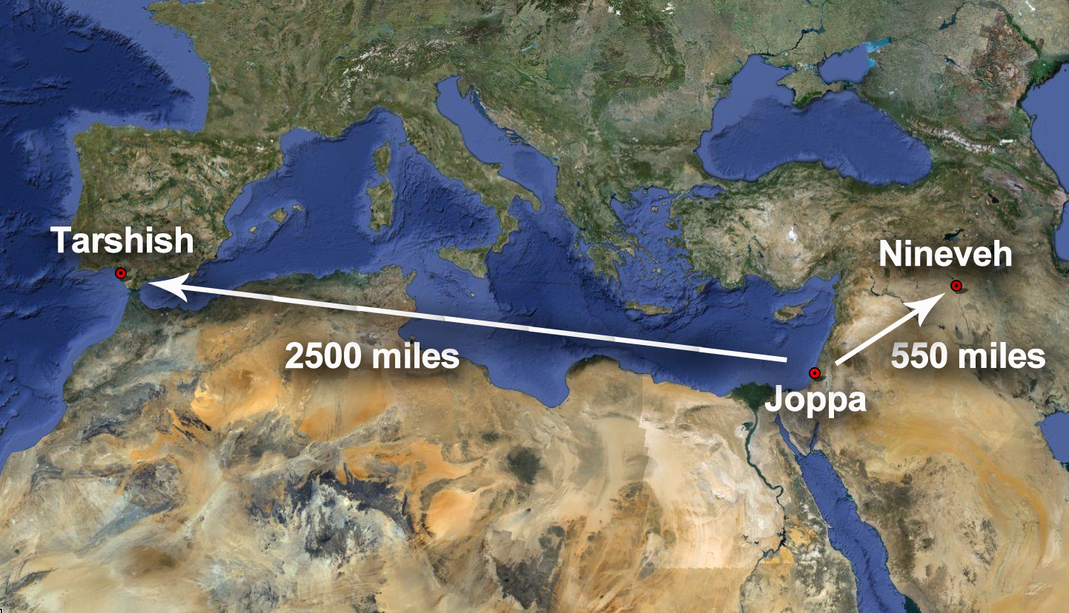
Jonah on the run
Obedience from disobedience. 1:1-17
Jonah flees from God’s presence.
The storm makes the sailors afraid and they pray to their gods.
Throw me into the sea.
The sailors turn to God.
Jonah1:6 "What do you mean, you sleeper? Arise, call out to your god! Perhaps the god will give a thought to us, that we may not perish."
THE CHALLENGE TO OBEY

Slide 3
Jonah on the run
Forced obedience. 2:1-10
God puts Jonah in a fish.
Jonah prays to God.
No mention of repentance.
God saved Jonah.
For 3 days and nights God is humbling Jonah and now he is fish vomit.
God calls Jonah a 2nd time.
THE CHALLENGE TO OBEY

Slide 4
A Contrast of hearts
Willing repentance. 3:1-10
Jonah’s message: 40 days until destruction.
Nineveh reacts with repentance.
The king’s reaction.
Removes his robe
Puts on sackcloth and sits in ashes
Decrees a fast of all people and animals.
Their hearts were willing to turn towards God.
THE CHALLENGE TO OBEY

Slide 5
A Contrast of hearts
Unyielding pride. 4:1-11
Jonah is angry with Nineveh and God.
He hates that God is gracious towards these people.
God shows Jonah grace.
Why doesn’t Jonah repent and obey God?
His heart was full of pride and selfishness.
“Jonah gets the miracles, Nineveh gets only preaching; Jonah runs from God, Nineveh runs to God; Jonah despises God for His mercy, they accept God’s mercy.” Phil Robertson
THE CHALLENGE TO OBEY

Slide 6
A Contrast of hearts
Don’t be like Jonah.
Pride and selfishness will destroy us because they are counter to the nature of God.
Rom. 12:3 “For through the grace given to me I say to everyone among you not to think more highly of himself than he ought to think; but to think so as to have sound judgment, as God has allotted to each a measure of faith.”
THE CHALLENGE TO OBEY

Slide 7
A Contrast of hearts
Check your heart.
The heart is the source of what we do.
We need to see ourselves for who we are – sinners in need of grace.
Mk. 7:20-23 “And He was saying, "That which proceeds out of the man, that is what defiles the man. (21) "For from within, out of the heart of men, proceed the evil thoughts, fornications, thefts, murders, adulteries, (22) deeds of coveting and wickedness, as well as deceit, sensuality, envy, slander, pride and foolishness. (23) "All these evil things proceed from within and defile the man."
THE CHALLENGE TO OBEY

Slide 8
How many times have you told God, “NO”?
THE CHALLENGE TO OBEY

