Slide 2
King Jehoshaphat
He is the 4th king of Judah.
In His reign
Teaches the Law to the people.
Allies with King Ahab
Established judges to maintain justice and promote obedience to God’s law.

Slide 3
King Jehoshaphat
The nations of Moab, Ammon and Edom rise up against Judah. 2 Chron. 20:1-2

Slide 4
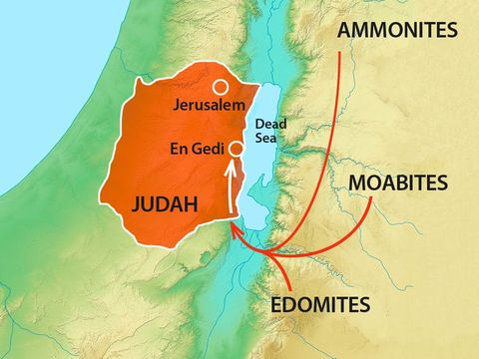

Slide 5
King Jehoshaphat
The nations of Moab, Ammon and Edom rise up against Judah.
Jehoshaphat is fearful.
He seeks God’s help.
He and the people fast before God.

Slide 6
Help For Helplessness
Jehoshaphat’s prayer v.6-13
He considers the greatness of God.
He recalls past promises.
He presents the problem.
He pleads for help.

Slide 7
Help For Helplessness
God’s response v.15-17
God’s response doesn’t come in great displays of power, but through one man.
“Don’t fear, the battle is not yours, but Mine.”
The people couldn’t stay home.
The army was to position themselves near the battle and see the salvation of God.
The people respond in worship.
1Cor. 10:13 “No temptation has overtaken you that is not common to man. God is faithful, and he will not let you be tempted beyond your ability, but with the temptation he will also provide the way of escape, that you may be able to endure it.”

Slide 8
Help For Helplessness
Victory through worship v.20-24
The challenge for us is to trust in God’s promises.
Jehoshaphat put singers on the front line.
The Lord acted when they sang.
The armies of Moab, Ammon and Edom destroy each other.
Do we see the power of song in our lives?

Slide 9
Help For Helplessness
“Just as singing is a natural effect of joy in the heart so it has also a natural power of rendering the heart joyful . . . There is nothing that so clears a way for your prayers, nothing that so disperses dullness of heart, nothing that so purifies the soul from poor and little passions, nothing that so opens heaven, or carries your heart so near it, as these songs of praise.
They create a sense and delight in God, they awaken holy desires, they teach you how to ask, and they prevail with God to give. They kindle a holy flame, they turn your heart into an altar, your prayers into incense, and carry them as a sweet-smelling savor to the throne of grace.” William Law

